Slide 1
Likes and Loves from the Literary Lists 2019 Edition Junior Books
February 7, 2019
www.mhaloin.com

Slide 2
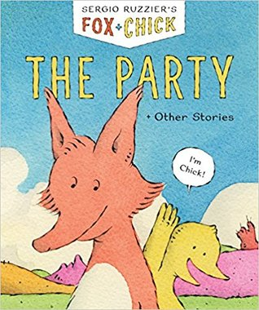
Beginning Readers
Oct. 2 →
3’40” Colby Sharp book preview
Chronicle Books Teacher’s Guide
30 sec. trailer with Mo Willems
Notes:
I Lost My Tooth! - IL: K-3; RL: 1.4 – Chapters and easy reading with lots of fun facts thrown in
Fox the Tiger – Fun read for 1st graders with humor. One of 4 Fox books in the My First I can Read series.
Fox+Chick: The Party + Other Stories ALA Notable Younger Fox and Chick manage to be good friends despite their differences in this uncluttered, laugh-out-loud early reader.

Slide 3
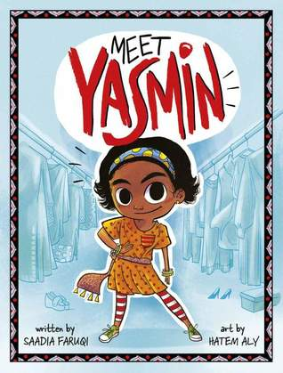
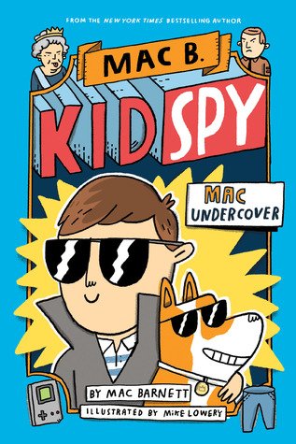
Younger Chapters – Series Green Dot at Broomfield - R3 DPL
Mid-continent Public Library
Juvenile Series & Sequels
Meet Yasmin 40” trailer and teacher’s guide at Capstone
Link to Mac Barnett’s 2014 Ted Talk
Why a Good Book is a Secret Door?
Notes:
Mac Undercover - IL: 3-6; RL: 5.0 Based on stories Mac would tell kids at summer camp to entertain them. Mac was called by the Queen of England to come and help find the stolen crown jewels. Humor and Mac Barnett is coming the Broomfield on March 17th for Junior One Book One Broomfield. Mac gave a great Ted Talk in 2014 & 2017 “why a Picture Book is a Secret Door”.
Meet Yasmin – Beginning reader series about an Indian American

Slide 4
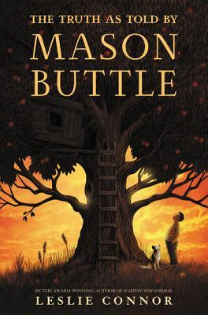
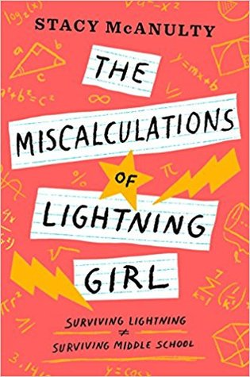
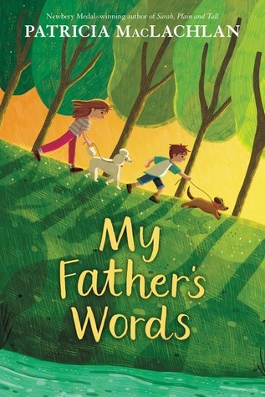
Realistic Fiction
Truth As Told By Mason Buttle Educator’s Guide pdf
Miscalculations of Lightning Girl Educator’s Guide
Wariing school arrangement of Dona Nobis Pacem
Notes:
Truth as told by Mason Buttle IL: 5-8; RL: 5.0 Learning Disabled Mason is the biggest, sweatiest kid in his grade. How can a teacher not love the model Ms. Blinny, and who of us wouldn’t be overjoyed to have a Dragon for all the struggling writers who have amazing stories waiting to get out. In this poignant and powerful mystery, Mason, a seventh-grade boy who can barely read and write, finds a way to finally tell the truth about what happened the day his best friend died.
Lightning Girl – IL: 3-6; RL: 6.3 Lucy is struck by lightning at age 8 and becomes an acquired savant – math genius. She has been homeschooled and is now being thrown into a conventional 7th grade.
My Father’s Words – 440Lexile Easy read with amazing characters – Fiona and Finn Dealing with Grief by reading to dogs in a shelter. Father’s favorite song was Dona Nobis Pachem. Links in author note to a beautiful playing.

Slide 5
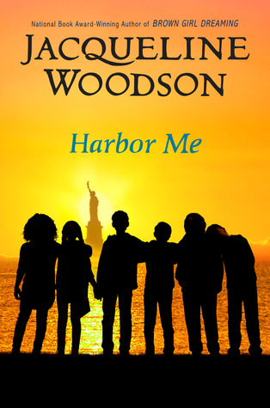
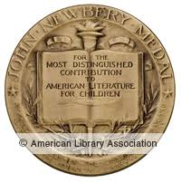
Contemporary Realistic Fiction
Sept. 11 →
5 minutes intro to book with Jacqueline Woodson
Random House Guide to all Jacqueline Woodson Books
2019 Newbery Award
Classroom Bookshelf Blog at SLJ for Merci Suarez Changes Gears
Notes:
Harbor Me - IL: 5-8; RL: 5.2 6 kids (5th and 6th graders are put into a room to talk the end of each school day)
Six children learn the power of sharing their stories when their teacher assigns them to spend Fridays in a weekly conversation circle.
Merci Suarez Changes Gears – IL: 3-6; RL: 6.3 Florida sixth grader Merci and her brother Roli are scholarship students in a Private School. This school year is particularly difficult as Grandfather Lolo has Alzheimers. Eleven-year-old Cuban American Merci Suárez balances the demands of her multi-generational family with the challenges of being a scholarship student at a private school in Florida.

Slide 6
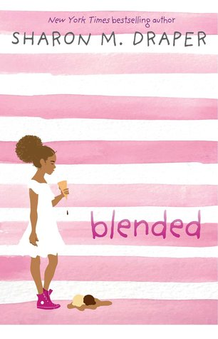
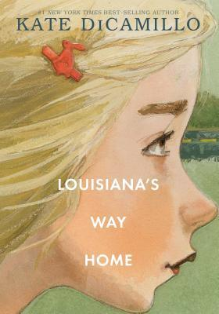
Broomfield Library Resources
Chapter Books for Beginning Readers
Children's Recommended Reads at Broomfield Library
November, 2018
Common Sense Media Review of Blended
Blended study guide
At Sharon M. Dtaper website
5 min. Booktalk of Louisiana’s Way Home by Colby Sharp
Notes:
Louisiana’s Way Home - IL: 5-8; RL: 6.4 (A Companion to Raymie Nightingale) Louisiana is in the “care” of her Granny traveling in Georgia – Meets a cadre of quirky and often loveable characters. Louisiana finds her own inner strength when her granny abandons her in a run-down motel while they attempt to lift a curse that has plagued their family for generations.
Blended - IL: 3-6; RL: 4.0- Izzy to her white mom and her boyfriend and Isabella to her black father and his family and she switches each week. As her brother is driving her to her recital they become the subject of racial profiling. (Many of the same themes as THUG) but for a younger reader.

Slide 7
Book lists for Banned Books Week
22017’s Alan Gratz story
Is set in a 4th grade.
Notes:
Property of the Rebel Librarian - Banned Books – When June Harper’s adults take strict parenting overboard at Dogwood middle school.
Ban This Book - Amy Ann, a quiet 4th grader who loves to read is upset when her favorite book is no longer in the library, so she ends up starting a Banned books locker library and works to get the books back into their school library.

Slide 8
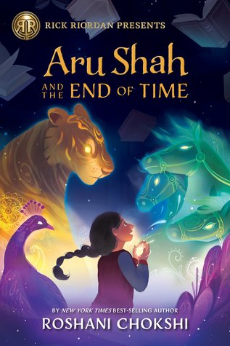
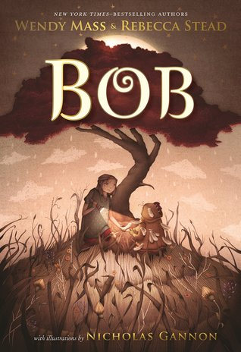
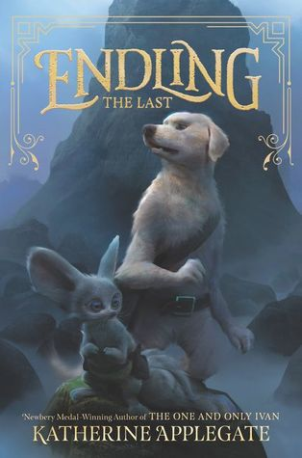
Fantasy
Bob Educator’s Guide
Endling Official Book Trailer in SafeShare
Make sure you are familiar with 2019 CCBA nominee Serpent’s Secret. Please have your students VOTE & NOMINATE for 2020
Notes:
Aru Shah - IL: 3-6; RL: 5.3 Rick Riordan First Imprint (4 book setIn this story inspired by the ancient Indian epic the Mahabharata, Aru Shah discovers she must enter the Kingdom of Death to save the world.
BOB IL: 3-6; RL: 5.6 Cowritten and Mass and Stead said they worked together so much that by the end they could not say who wrote what – made me thing of Velveteen Rabbit
Endling IL: 3-6; RL: 4.3. I love Katherine Applegate, but this really harkens back to her Animorphs series.

Slide 9
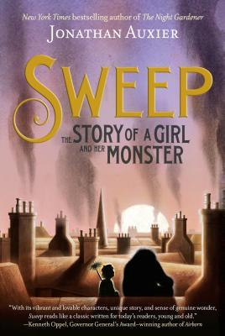
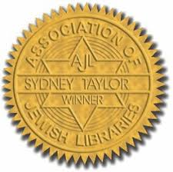
Fantasy/Historical/Traditional Literature
2019 Charlotte Huck Award for Older Readers from NCTE
2019 Sydney Taylor Award for Older readers from Association of Jewish Librarians
Link to TeachingBooks.net author name pronunciation
Notes:
Sweep - IL: 3-6; RL: 3.6 Love this story that took Jonathan Auxier 10 years to write. He includes the backstory in his Author’s note at the end. Great audio book, if doc camera or kids can follow text - So many examples of flashback and forward and clever wordplay that can’t be hear. Set in London 19th century before child labor laws regarding chimney sweeps.

Slide 10
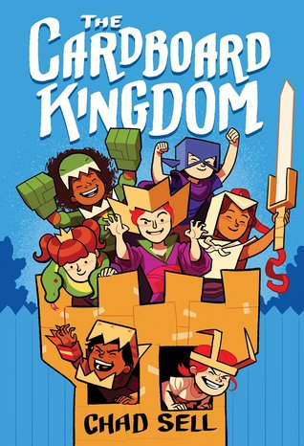
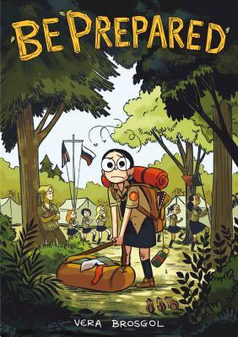
Graphic
Notes:
Be Prepared - Brogsol – For kids who love Jameson (Roller Girls) , Telgemeir (Sisiters), Hale (Real Friends) Memoir of summer camp for Russian American kids did remind me of my sleepover Jewish summer camp. Brosgol comically recounts her experiences at a summer camp for Russian American kids in this graphic memoir. ALA Notable older readers
New Kid - Really won’t come out until March, but I read an ARC from the Tattered Cover’s Teacher Night.
Cardboard Kingdom – IL: 3-6; RL: 2.9 Stories by 10 artists of a group of 16 kids and their summer of immaginative play.
Cardboard Kingdom – Great story of a group of creative kids who spend a summer involved in imaginary and creative play.

Slide 11
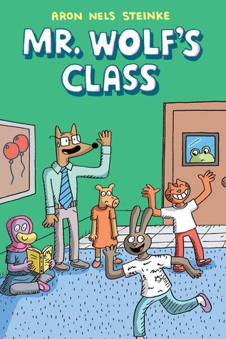
Graphic
Mr. Wolf’s Class Trailer at Scholastic
Notes:
New Kid – 2019 Already Getting 4* - 7th graders experience in a not so diverse school. Not just for kids as a teacher this made me reflect in good ways. Calling students by their names.
Mr. Wolf’s Class – author is a 4th/5th grade teacher and really does have a great feel for what goes on in a classroom. Laugh and kids love the graphic and humor.

Slide 12
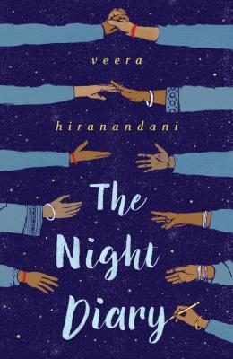
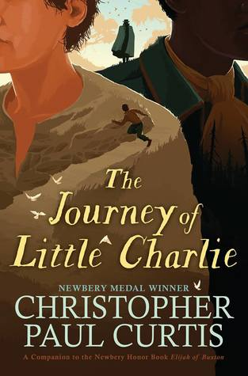
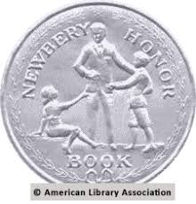
Historical Fiction
2019 Newbery Honor Book
Read Brightly Night Diary Book Club Selection
SLJ Blog Classroom Bookshelf The Night Diary
Notes:
Journey of Little – Difficult read as it is written in dialect, but great to listen to audio book. - Monica Edinger – my favorite reviewer. Story of child of sharecroppers who in order to work off his families debt is sent with Capn Buck to capture some previously enslaved people. Set just after the civil war.
Night Diary – Newbery Honor IL: 3-6; RL: 3.8 Written in the form of 12 year old Nisha’s letters to her mother (who died giving birth to her and her twin). Follows as she becomes an immigrant during the 1947 partitian of India and Pakistan
Told in the form of diary entries addressed to Nisha’s dead mother, this novel traces a mixed-faith family’s flight from Mirpur Khas, Pakistan, to Jodhpur, India, during the partitioning of India in 1947

Slide 13
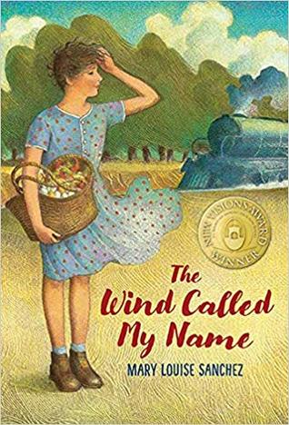
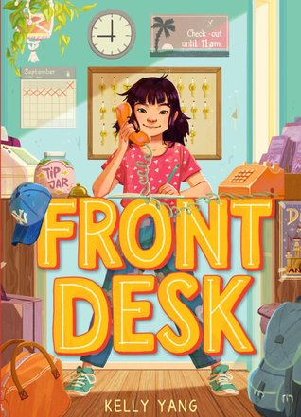
Historical Fiction
Notes:
Front Desk - Set in Anaheim, CA in 80’s this has some elements of memoir of Kelly Yang’s experience as an immigrant. ALA Notable middle grades Mia not only helps manage the front desk of the motel where her immigrant Chinese parents work; she also helps keep secrets about the guests, whose immigration status puts everyone at risk.
Wind Called My Name – Colorado Author. Magarita, during the great depression has to move with her family (familia) from New Mexico to Fort Steele, Wyoming (in much the same way the author’s grandmother did). Book can serve as an alternative for some teachers who wish to forgo Little House books but still want historical fiction about life in the west in the 1930’s. Each chapter is a somewhat complete story and some can be used as stand alone read alouds. Margarita befriends

Slide 14
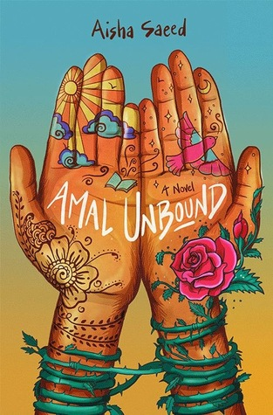
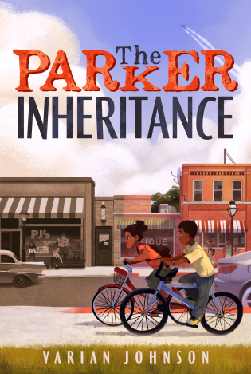
Historical/Contemporary/Social Political
Backstory at Varian Johnson website
Notes:
Ghost Boys
Parker Inheritance IL: 3-6; RL: 5.9 Issues of race, bullying, and identity are interwoven in this buried-treasure mystery that spans multiple decades as tween Candice unravels a series of puzzles in her community.
Amal Unbound - Unknowingly, Amal insults a corrupt but powerful man in her small Pakistani village. As retribution, he claims her as an indentured servant.
Ghost Boys - This novel explores the issues of racial violence and police brutality from the viewpoint of Jerome, the ghost of a 12-year-old black boy gunned down by a white police officer.

Slide 15
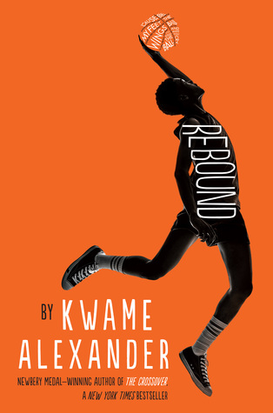
Novels in verse
Rebound on The Classroom Bookshelf Blog at School Library Journal
Notes:
Rebound IL: 5-8; RL: 4.0 The prequel to Newbery winner The Crossover. This tells the story of Jorden and Josh’s father Chuck and how he became the basketball father of the previous book.
After being sent to his grandparents’ house for the summer, Chuck Bell finds his groove through basketball, comics, and exploring his roots in this companion title to 2015 Newbery winner The Crossover.

Slide 16
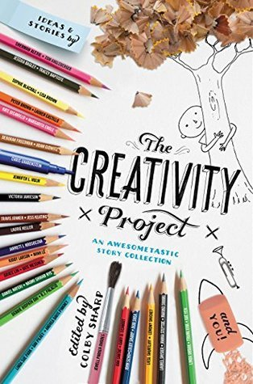
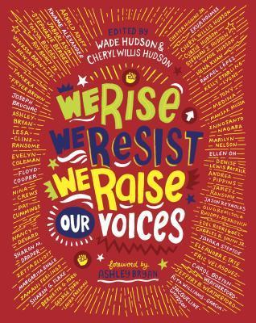
Anthologies/Story Collections/Sports
Notes:
Creativity Project March 13, 2018 - prompts and responses by 44 of my favorite authors edited by Colby Sharp
We Rise, We Resist, We Raise Our Voices – 50 diverse authors and illustrators anthology. Donalyn Miller “Outstanding #ownvoices collection of poems, essays, and illustration.”

