Slide 1
Likes and Loves from the Literary Lists 2020 Edition Junior Books
February 6, 2020
www.mhaloin.com

Slide 2
Scholastic Acorn Imprint
1.5 min. World Read Aloud Day with Jonathan Finske
Notes:
Hello Crabby – RL 1.8 370L
Crabby and Plankton friendship in vein of Narwhal & Jellyfish
Mister Shivers – 460L – 5 scary short stories Max Brallier
Perhaps this series will find a home in Children’s Choices.
The five stories here are about 1. a dare 2. body horror 3. a witchy yard sale 4. a messy child being punished 5. living in a dangerous new home

Slide 3
Beginning Reader Graphic Series
2020 Geisel
Honor Book
30 min. Cece Bell at 2019 National Book Festival
Ruzzier also had a picture book called Good Dog this year
2020 ALA Notable Younger
11 min. preview with Drew Daywalt
Notes:
Chick & Brain – replacements for Dick & Jane – Silly, funny, two friends with both visual and verbal humor.
Chick (a baby chicken) instructs his friend Brain (underwear-clad human with an exposed brain) in good manners. (Geisel Honor Book)
Monkey & Cake Series – 330L - Schrödinger's cat meets 'Piggy & Elephant’
Fox & Chick Quiet Boat Ride 400L– 3 chapters with humorous stories understanding personalities and friendships.
Ruzzier also a picture book Good Dog this year.

Slide 4
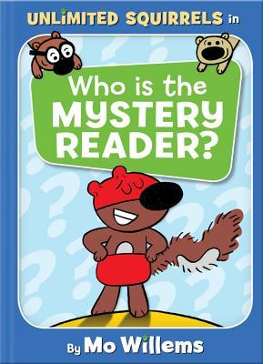
Mo Willems Unlimited Squirrels Series
Pigeon Presents Website
11/2 min. triler to I lots My Tooth
Notes:
RL 1.7 IL K-3
Flummoxed by a sign they can't read, the squirrels are helped by the Mystery Reader who teaches them to sound out words they're not sure about.
As Zoom Squirrel and his friends try to identify the mystery reader, they learn about books, how they are written, and how to read--while sharing a-corny jokes

Slide 5
Contemporary Realistic Fiction
May 7, 2019
2020 ALA Notable Middle
2020 Schneider
Familh Book Medal
5 min. Colby Sharp as a read aloud
Teache's Guide at Random House
^
Feb. 5, 2019
2020 Schneider Family Honor Book
Notes:
.
Each Tiny Spark RL 4.4 680L,
Own Voices Story where author has a child with some of the traits of the main character. Covers a lot of how students can do research and follow their own interests. Also follows a theme of parents in the military. Sixth-grader Emilia Torres struggles with ADHD, her controlling abuela, her mother's work commitments, her father's distance after returning from deployment, evolving friendships, and a conflict over school redistricting.
Shouting at the Rain 3.7 HL: High-Low 560L
This one also hones in on how we can change our perspective to understand that things aren't usually as bad as we think they are. Several memorable moments: - For teachers who need examples of Beers/Probst signposts, there is a perfect Words of the Wiser scene on pp. 199-201. - The precious moment between Delsie and Grammy at the end of chapter 40 - reminds me of the scene in Inside Out (might be my favorite Pixar movie) among Sadness, Bing Bong, and Joy about Riley. - The anagrams! - Mullaly's beautiful Dear Reader letter and Acknowledgements
Song for a Whale IL: 3-6; RL: 5.6 800L
From fixing the class computer to repairing old radios, twelve-year-old Iris is a tech genius. But she's the only deaf person in her school, so people often treat her like she's not very smart. Deaf Culture. Author is a sign language interpreter.

Slide 6
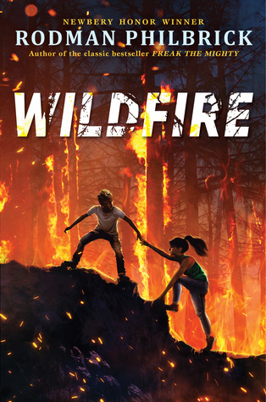
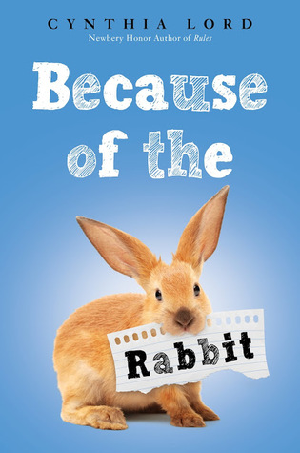
Contemporary Realistic Fiction
Sept 3,
2019
ARC ->
2020 ALA Notable Middle
2 min. intro with Rodman Philbrock
Classroom Bookshelf of activities to start year with Because of the Rabbit
2 min. intro by Cynthia Lord
Notes:
Pay Attention Carter Jones GL 5.3 840L
The Butler Mr. Bowles-Fitzpatrick shows up just when Carter is starting 6th grade. Carter’s father is stationed in Germany and he has a lot of responsibility to help his working mother with his 3 sisters. The humor and heart is evident as Mr. Bowles Fitzpatrick sends the kids off each day to “Make good decisions and remember who you are.”
Wildfire GL 4.5 700L
Sam is at a summer camp in Maine when the camp is evacuated because of a forest fire nearby. He has run back to grab his phone charger, and the bus leaves without him! Forward and back matter make this great and timely.
Because of the Rabbit GL 4.3 660L
Emma helps her father rescue a pet rabbit that supports her socialization as she transitions into public school.
Emma’s goal after starting public school is to make a friend. She ends up with Jack and they are drawn together by the attempts to rescue a rabbit. Based on Author’s experience.

Slide 7
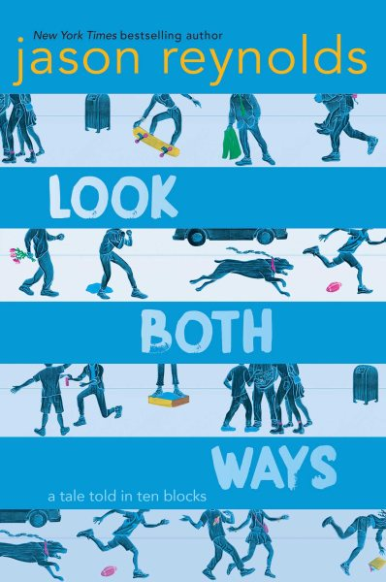
Contemporary Social/Political
2020 Walter Honor
2020 ALA Notable Older
Jason Reynolds "National Ambassador for Children's Literature" reads aloud 1st chapter
Teacher’s guide from Macmillan
Teaching Guide at Balzer & Bray
Notes:
A Good Kind of Trouble IL: 3-6; RL: 4.8
Ramée's book remembers to capture some of the highs, lows, and petty details of Middle School alongside the serious topics of the Black Lives Matter movement. This makes it accessible and relatable
Coyote Sunrise IL: 3-6; RL: 5.7
Five years. That's how long twelve-year-old Coyote and her dad, River, have lived on the road in an old school bus, criss-crossing the nation. It's also how long ago Coyote lost her mom and two sisters. Coyote hasn't been home in all that time, but when she learns that the park in her old neighborhood is being demolished--the very same park where she, her mom, and her sisters buried a treasured memory box--she devises an elaborate plan to get her dad to drive 3,600 miles back to Washington state . . . without him realizing it.
Look Both Ways
IL: 5-8; RL: 5.7
A novel told in 10 blocks – Almost 10 short stories tied together
What happens after school? These 10 interconnected stories will tell you, block by block.

Slide 8
2019 Global Read Aloud – Pernille Ripp
Author Trailer for Bridge Home
teachingbooks.net author pronunciation guide
Padma Venkatraman debut novel
2020 ALA Notable Middle
February 5, 2019
Notes:
Bridge Home – 5-8; RL: 4.0 (also available in audiobook, narrated by the author)
Four determined homeless children make a life for themselves in Padma Venkatraman's stirring middle-grade debut.
Global Read Aloud
Viji and Rukku are joined by two homelss boys Muthi and Arul to make their living in the trash heaps of Chennai India.

Slide 9
Fantasy
2020 ALA Notable Older
2020 Pura Belpre Award – Portray Affirm and Celebrate Latino Experience
2020 ALA Notable Middle
One minute book trailer by Harper Collins.
5 min with Rick Riordan and Carlos Hernandez
a
Notes:
Sal and Gabi Break the Universe - IL: 3-6; RL: 4.8
thirteen-year-old Sal Vidon and Gabi Real actually get together to ”save” the universe by being able to reach into the universe and draw out chilckens (and even Sals mother). Fantasy filled with humor and heart.
Sci-fi adventure and Cuban culture blend as Sal Vidón and his friend Gabi travel to parallel universes and try to survive middle school. (Belpré Author Award Book)
Lalani of the Distant Sea - IL: 3-6; RL: 4.8
Lalani must leave Sanlagita and find the riches of the legendary Mount Isa, which towers on an island to the north. Her adventure quest is filled with adventure.

Slide 10
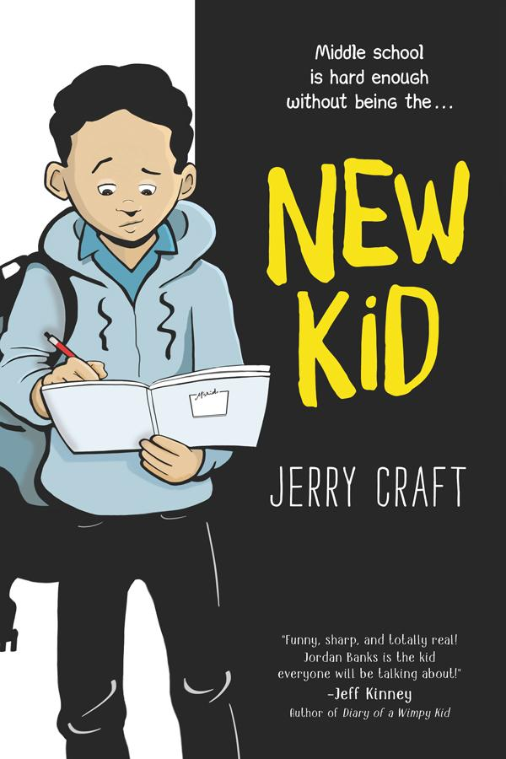
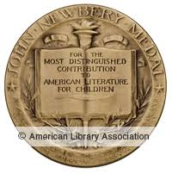
Graphic
New Kid at The Classroom Bookshelf
2020 ALA Notable Older
5 min. blindfolded drawing challenge
1 min trailer New Kid
5 min. for adults with Jerry Craft
2020 Coretta Scott King Author Medal
2020 Newbery Medal
Notes:
New Kid -IL 5-8; RL: 3.6
Seventh grader Jordan Banks stars in an honest graphic novel about starting over at a new school where diversity is low and the struggle to fit in is real.
Not just for kids as a teacher this made me reflect in good ways. Calling students by their names. Set in New York. Humor -
.

Slide 11
Historical Fiction
One minute book trailer in YouTube
2019 Charlotte Huck Award for Older Readers from NCTE
2019 Sydney Taylor Award for Older readers from Association of Jewish Librarians
Educator's guide at Random House
Link to TeachingBooks.net author name pronunciation
Notes:
White Bird – R.J. Palacio
Julian’s grandmother’s story.
IL: 5-8; RL: 4.7
Audiobook is a full cast audio which really works well for following the visual graphic novel while
Grandmère’s heartrending story: how she, a young Jewish girl, was hidden by a family in a Nazi-occupied French village during World War II; how the boy she and her classmates once shunned became her savior and best friend.

Slide 12
Graphic Memoir
2 min. Intro by Raina Telgemeier
2020 Asian Pacific Children’s Literature Award
Best Friends Trailer
2020 ALA Notable Middle
Guts trailer
Peek Inside at Macmillan
Notes:
Stargazing – Level 2.5 GN 510L
Story of Moon and Christine unlikely best friends in Chinese American Community
Jen Wang draws on her childhood to paint a deeply personal yet wholly relatable friendship story that’s at turns joyful, heart-wrenching, and full of hope.
Despite opposite personalities, Moon and Christine develop an unlikely friendship in this lively graphic novel.
Best Friends - IL: 3-6; RL: 4.6
Sixth grade is supposed to be perfect, but Shannon has difficulty understanding the rules.
Guts -IL: 3-6; RL: 3.6
TC and Pop Culture Classroom brought her to CO and it was the largest author visit I’ve attended in Denver.

Slide 13
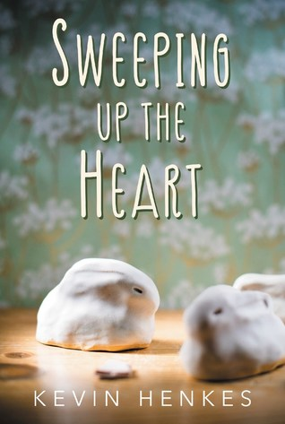
Historical Fiction
33 min. Colby Sharp about Sweeping Up The Heart
2020 ALA Notable Older
Discussion Guide at Candlewick
April 16, 2019
What Parent's need to know at Common Sense Media
Kevin Henkes talking about his book
Notes:
Beverly Right Here – JOBOB – March 13 - IL: 5-8; RL: 3.8
Also at Douglas County Library
Beverly has run away and is determined to make it on her own. After the loss of her beloved dog, Beverly runs away from home and starts a new life
Sweeping Up the Heart IL: 3-6; RL: 6.0 After an eventful spring break, seventh-grader Amelia Albright's life changes forever. When she spends spring break
1999 in Madison WI – Friendship Kids artist decisions.
Line Tender IL: 5-8; RL: 7.0 Story of loss explores life in and out of the ocean
Age 11+ on Common Sense Media
Parents need to know that Kate Allen's The Line Tender deals with deaths of a parent and a peer. Underage drinking and consequent risky behavior result in a character's death. Some nonsexual adult nudity, adult drunkenness, and neglectful parenting take place. Lucy has trouble swallowing because of a traumatic event, and she loses a lot of weight as a consequence, An extremely graphic autopsy of a shark includes description of dead shark pups still in the mother shark's uterus. The mother shark's jaws are sawed out of her mouth: "It was a bloody mess that turned all of the shark's white parts pink-orange." A character then holds the "dripping jaws" in the air and has a photo taken. Though done in the name of biology, the dissection is graphic and could be jarring to sensitive readers.ine Tender IL: 5-8; RL: 7.0 Story of loss explores life in and out of the ocean

Slide 14
Historical Fiction
October 1, 2019
ARC
2 min 12 sec. trailer on YouTube
2020 ALA Notable Older
Notes:
Words on Fire 5.6 820L
Set during the nineteenth-century Russian occupation of Lithuania, Audra and her family smuggle books to save Lithuanian language and culture.
Danger is never far from Audra's family farm in Lithuania. She always avoids the occupying Russian Cossack soldiers, who insist that everyone must become Russian -- they have banned Lithuanian books, religion, culture, and even the language. But Audra knows her parents are involved in something secret and perilous.

Slide 15
American Indian
Extensive teacher's guide from publisher
Christine Day author website
teaching ideas at theclassroombookshelf
2020 ALA Notable Middle
Notes:
I Can Make this Promise IL: 5-8; RL: 6.2
All her life, Edie has known that her mom was adopted by a white couple. So, no matter how curious she might be about her Native American heritage, Edie is sure her family doesn’t have any answers. Until the day when she and her friends discover a box hidden in the attic—a box full of letters signed “Love, Edith,” and photos of a woman who looks just like her
Twelve-year-old Edie discovers a box in her family’s attic that reveals her mother’s Suquamish/Duwamish heritage
Indian no More – target audience grades 4-7
In 1954, Regina and her family move from their reservation to Los Angeles after their tribe is terminated by the U.S. government.

Slide 16
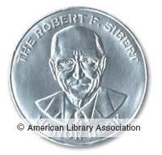
Novels in verse
2 min. author interview at teaching books.net
2020 ALA Notable Older
2020 ALA Notable Older
www.vocabulary lessons for Other Words...
2020 Walter Honor
Notes:
Other Words for Home RL 5.3 930L
Jude must leave Syria to eventually make her home in Cincinatti
Themes of conflict, home, identity, the arts, and prejudice are interwoven in this powerful verse novel about a Syrian girl’s new life in America. (Newbery Honor Book)
The Promise of Change: One Girl’s Story of the Fight for School Equity Level 6.3, Lexile 1000
A first-person, verse account of the challenges faced by the first African American students to integrate into an American high school. (Sibert Honor Book)

Slide 17
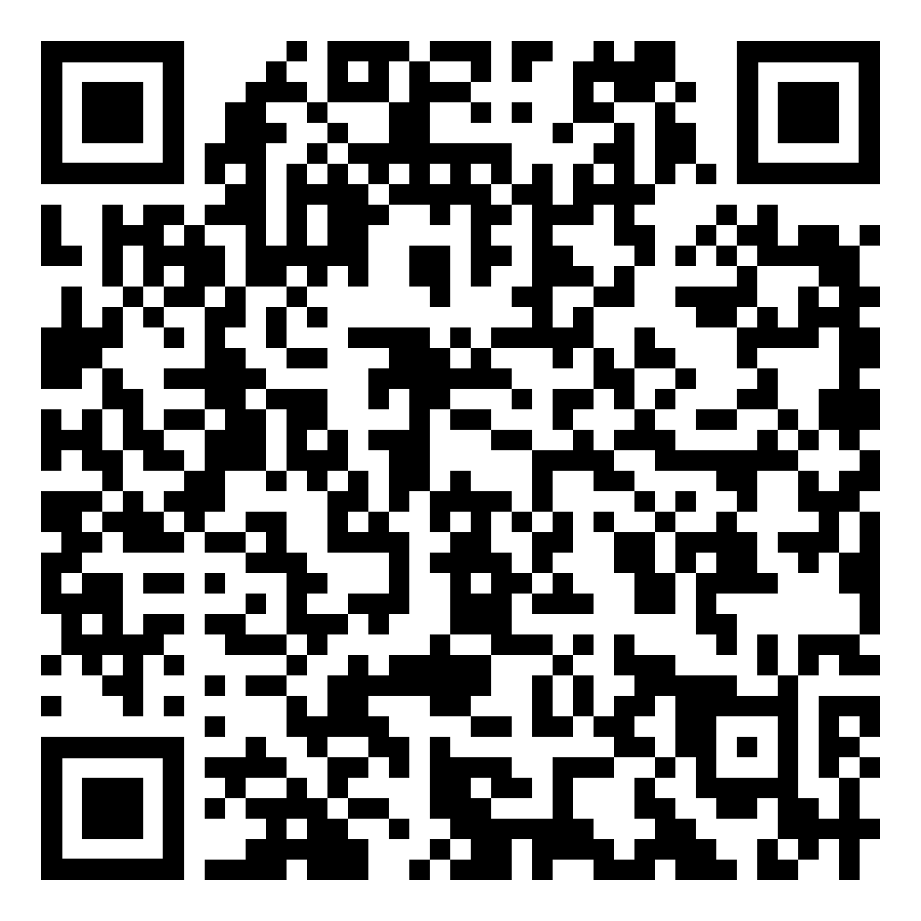
Likes and Loves from the Literary Lists 2020 Marcie Haloin Session #148 Thursday Feb. 6

