Slide 1
Likes and Loves from the Literary Lists 2022 Edition Junior Books
February 11, 2022
www.mhaloin.com

Slide 2
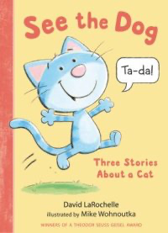
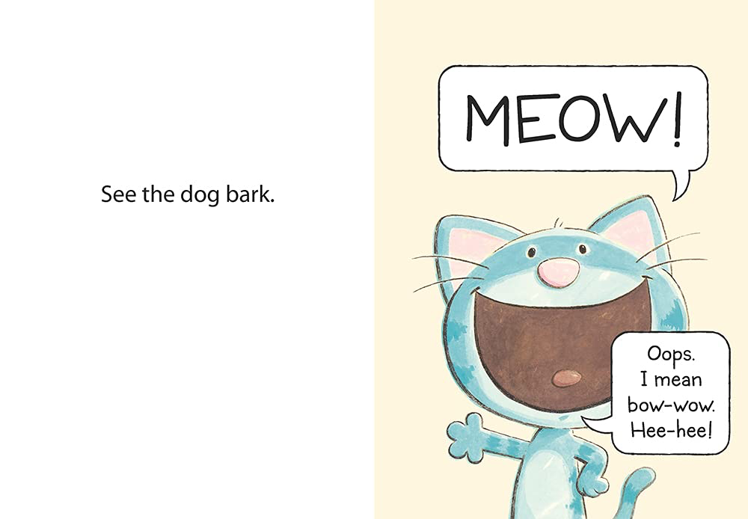
Beginning Reader
Peek Inside at Penguin/Random House
David LaRochelle website
Notes:
See the Dog – 2*, September 14, 2021 4-8 year olds, Primer with 3 characters, Dog, Cat, and the Book. Graphic with 3 short stories. Sequel to last year’s See the Cat. Dog is sick, so cat is the dog for a day.
Fergus and Zeke and the 100th Day of School – December 14, 2021 – 4 chapters about collections the kids are making as are the mice.

Slide 3
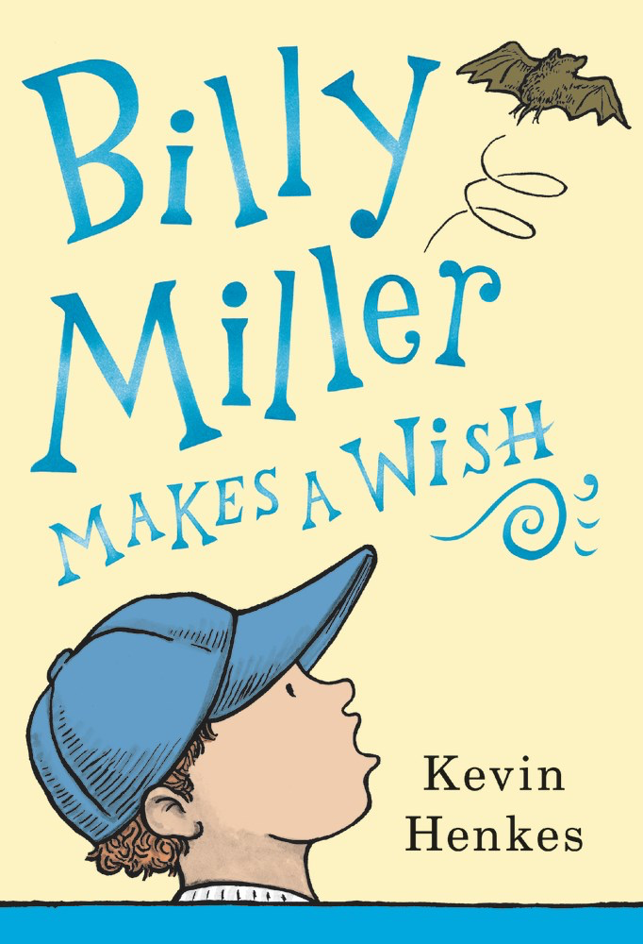
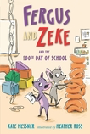
Early Chapter Books
December 14, 2021
Teacher's Guide to Billy Miller Makes a Wish and The Year of Billy Miller
Title link for this 4th book in the Series at Candlewick
Notes:
Billy Miller Makes a Wish 4* Int Lvl: 3-6; Rd Lvl: 5.8 A Stand-alone Companion to The Year of Billy Miller (2013, Greenwillow), Horn Book Fanfare. On his birthday Billy makes a wish for something excited to happen, but immediately regrets it when his elderly neighbor ends up in the hospital. Humor and heart. Just a sweet read that really reminds and in many ways pays tribute to Beverly Cleary in a ways that are different than the Renee Watson books. I can see it as a lovely Kinder or first read aloud because of the completeness of each chapter.
Fergus and Zeke and the100th Day of School – Kirkus Best Books, 4th in Series -

Slide 4
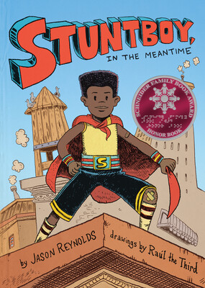
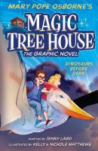
Graphic Novels
June 15, 2021
Nov 30, 2021
MagicTreehouse website at Penguin/Random House
Megan Wagner Lloyd Website
Scholastic Bookfair Trailer
Simon and Schuster, group guide, excerpts
2022 Schneider Family
Book Award Honor Book
Notes:
Stuntboy in the Meantime, November 30, 2021, GN 649L, GL2-5, 4*, illustrated by Raul The Third Jonker/Schu #7 Another Year of Reading
Portico Reeves’s superpower is making sure all the other superheroes—like his parents and two best friends—stay super. And safe. Super safe. And he does this all in secret. No one in his civilian life knows he’s actually…Stuntboy!
Magic Treehouse The Graphic Novel: Dinosaurs Before Dark- GN 110L, Adapted by Jenny Laird, illustrated by Kelly & Nichole Matthews Retells, in graphic novel form, the tale of eight-year-old Jack and his younger sister Annie, who find a magic treehouse which whisks them back to an ancient time zone where they see live dinosaur June 15, 2021
Allergic – GN 230L – Maggie wants a pet but she is allergic. Memoir of author’s experience with allergies and new siblings.

Slide 5
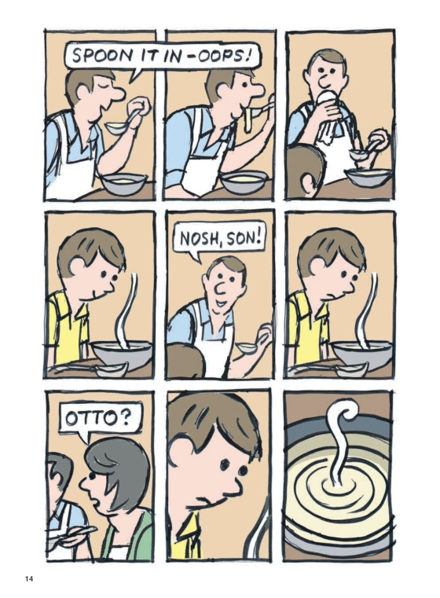
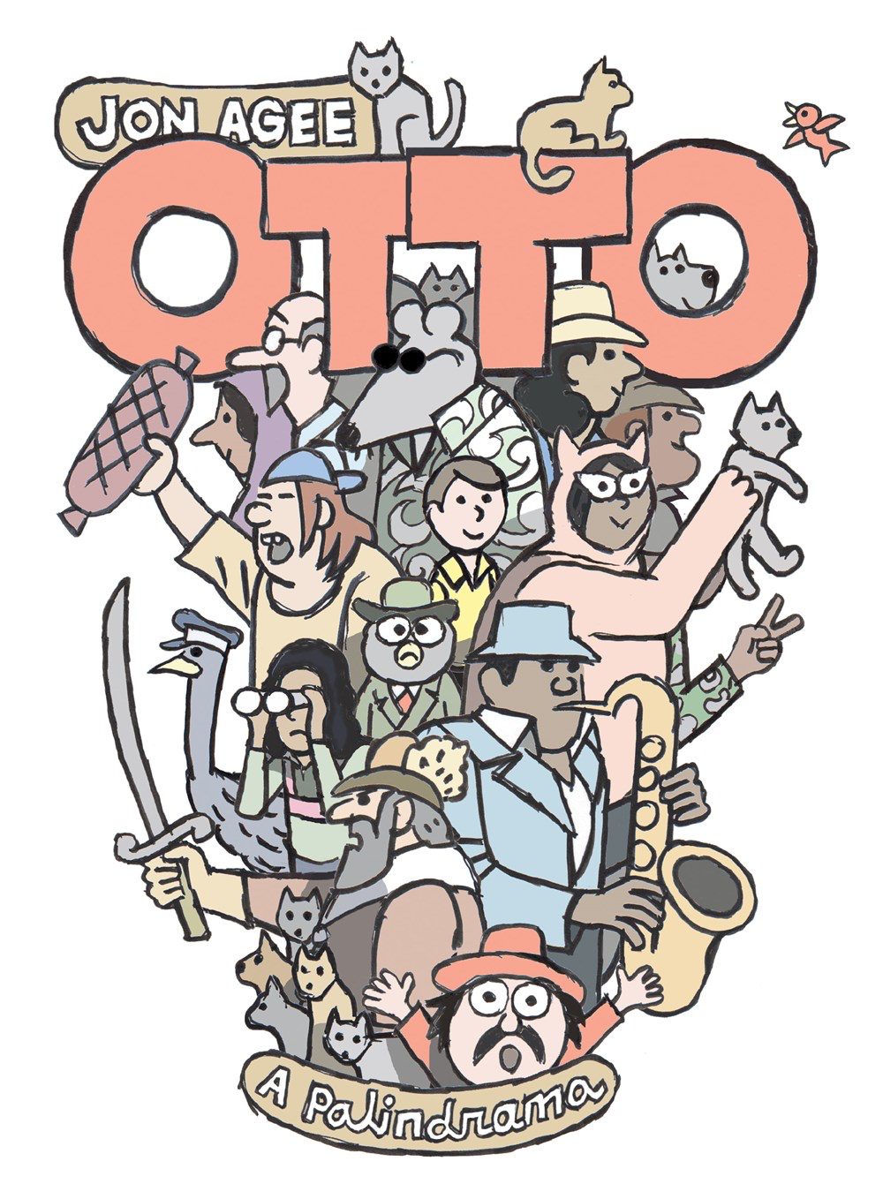
Wacky Wordplay
Jon Agee Website with trailer & interview links
Notes:
Otto: A Palendrama – December 28, 2021 – 1*, An amazing graphic novel with setting, characters (Otto and his pet Pip) who take a day at the beach and amusement park and hopefully get back to his Mom and Pop.

Slide 6
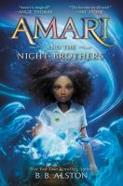
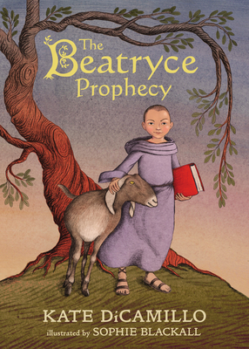
Fantasy
2022 ALA Notable Middle
Jan. 19, 2021
2022 ALA Notable Middle
Teaching Guide for Amari
Candlewick with link to Teacher's Guide
one min. book trailer
Notes:
Alston, B.B., Amari and the Night Visitors 4*, January 19, 2021, NPR Best, DPL Staff Favorites SLJ Best Middle Grade Int Lvl: 3-6; Rd Lvl: 5.2
First Book in series and has been picked up for a Universal Movie. Amari, a 12-year-old African American girl who's recruited by a secret organization that maintains order in the supernatural world. The book is the first of a planned trilogy and has been optioned for a film adaptation by Universal Pictures. There are a couple of fights between people, with hitting and kicking, and weapons battles with supernatural creatures that result in death.
“Amari investigates her brother’s disappearance while navigating a magic-filled summer internship at the secret Bureau of Supernatural Affairs. ”ALA
Beatryce Prophecy September 28, 2021 RL 4.4, IL Jonker/Schu #1 Grades 3-7 SLJ Best Books 2021, CCB Blue Ribbon
From two-time Newbery Medalist Kate DiCamillo and two-time Caldecott Medalist Sophie Blackall comes a fantastical meditation on fate, love, and the power of words to spell the world.
“A prophecy sets a medieval adventure in motion that involves a mysterious girl, a feisty goat, a boy with a tragic sword, a missing king, and an empathetic monk.”

Slide 7
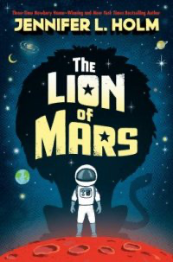
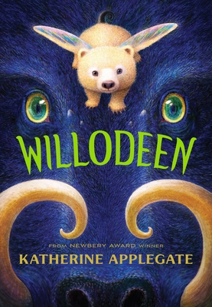
Fantasy and Nature
September 7, 2021
1 min. Katherine Applegate introduces the animals of Willodeen
Book page at Penguin Random House
Notes:
Willodeen September 7, 2021, Jonker/Schu #8 “Willodeen” is to ecology and nature as “Wishtree” is to acceptance and kindness., Willodeen tackles the ravages of climate change and the symbiotic relationships in nature with a cast of the most whimsical creatures EVER. Read aloud for grades 3 up because of fire and reality of nature.
Lion of Mars – January 5, 2021 530L, - 2* RL 4.9 Kids who have grown up in isolated colonies on Mars need to discover the secrets of the adults to save and unite the planet.

Slide 8
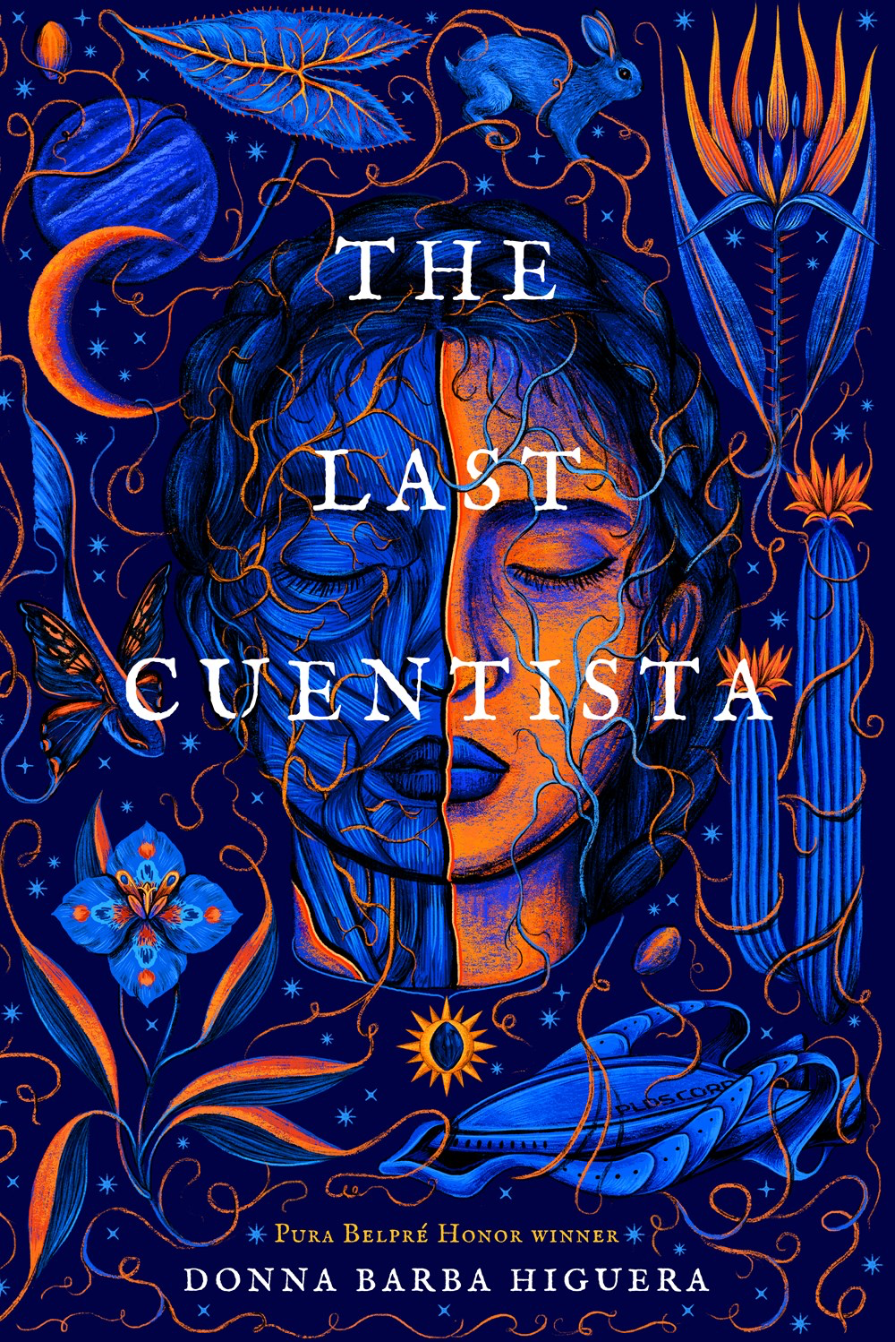
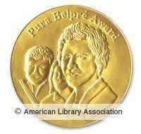
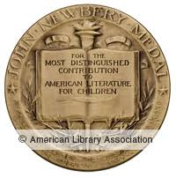
Science Fiction/Young Adult 2022 Newbery Medal 2022 Pura Belpre Medal
Teaching Guide / Levine Querido Publisher
3 minute introduction by author Donna Barba Higuera
Pura Belpre Award 2022
2022 ALA Notable Older
2022Newbery Medal
Notes:
Last Cuentista, October 12, 2021, 2022 Newbery and Pura Bel
Petra Pena GL 5-9, Reading Age 20-14
Dystopian and science fiction novel. There lived a girl named Petra Peña, who wanted nothing more than to be a storyteller, like her abuelita. But Petra's world is ending. Earth has been destroyed by a comet, and only a few hundred scientists and their children – among them Petra and her family – have been chosen to journey to a new planet. They are the ones who must carry on the human race.Hundreds of years later, Petra wakes to this new planet – and the discovery that she is the only person who remembers Earth. A sinister Collective has taken over the ship during its journey, bent on erasing the sins of humanity's past. They have systematically purged the memories of all aboard – or purged them altogether. Petra alone now carries the stories of our past, and with them, any hope for our future. Can she make them live again?
“Centuries after Earth is destroyed, Petra arrives on a new planet, where she uses traditional stories and cunning to outwit enemies and rescue other survivors”ALA

Slide 9
Contemporary Realistic Fiction
Pronounce author's name at teachingbooks.net
September 20, 2021
Padmaven Katraman website
5 min. Colby Sharp as a read aloud
Teache's Guide at Random House
Notes:
Born Behind Bars Lvl: 5-8; Rd Lvl: 3.0 Jonker/Schu #5, SLJ Best Books, In Chennai, India, after spending his whole life in jail with his mother, who is serving time for a crime she did not commit, nine-year-old Kabir is suddenly released and has to figure out how to survive on his own in the outside world.

Slide 10
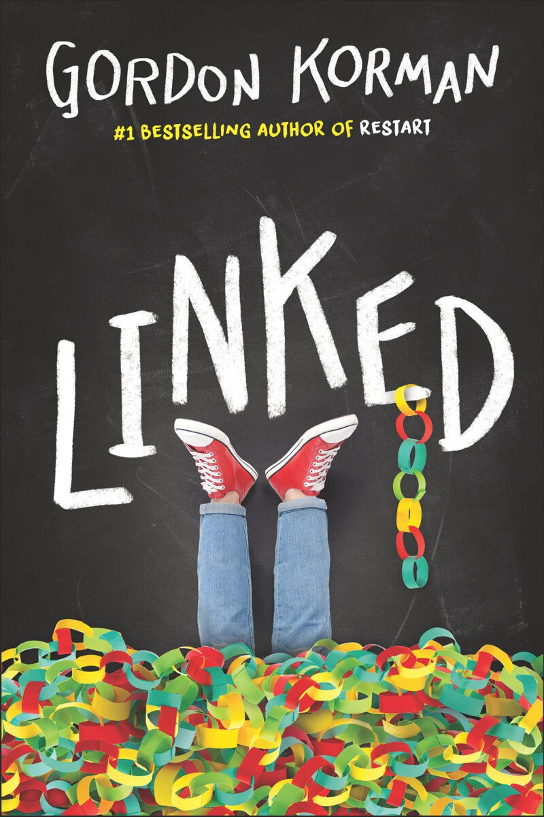
Contemporary Realistic Fiction/ Mystery Adventure
Sydney Taylor
Honor
Gordon Korman Website
Notes:
Linked: July 20, 2021, Link, Michael, and Dana live in a quiet Colorado town. But it's woken up very quickly when someone sneaks into school and vandalizes it with a swastika. Nobody can believe it. How could such a symbol of hate end up in the middle of their school? Who would do such a thing? Has many parallels to War Stories which was on last year’s CCBA nominees. Korman will be at the conference on Thursday.

Slide 11
Collective Biography
1 hour booktalk at the Museum of Jewish Heritage
Book page at Penguin/Random House
Notes:
RBG’s Brave September 21, 2021 1120L, SLJ Best 2021 – Non-fiction – 2*
Gr 3-6–Epstein, with the collaboration of Ruth Bader Ginsburg, profiles 33 Jewish women who “transcended what was expected, allowed, or tolerated for a woman of their time.” Whether reading from cover to cover or just browsing, kids will find inspiration in the lives of these brave and brilliant women.

Slide 12
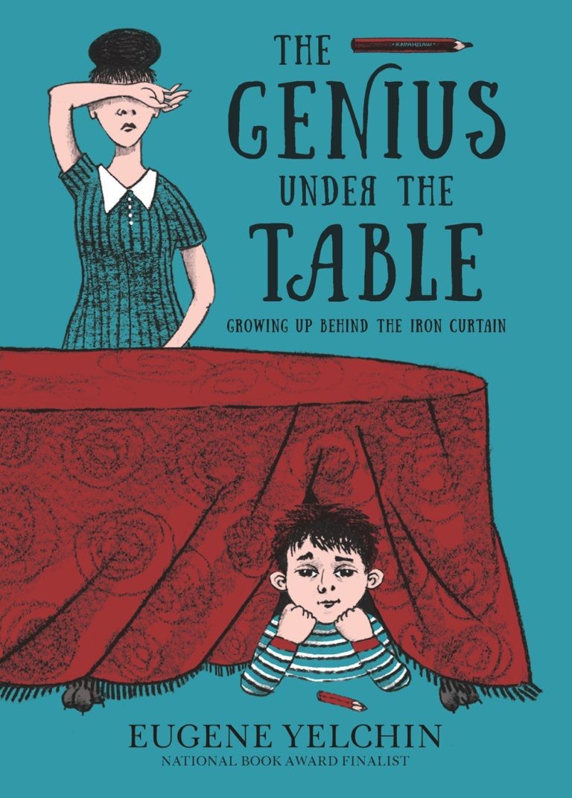
Historical Fiction and Historical Memoir
Feb. 22, 2021
Educator's guide at Holiday House also interview with author and other materials.
Sydney Taylor
Honor
2022 ALA Notable Older
2022 ALA Notable Older
Discussion Guide from Candlewick
December 14, 2021
Notes:
A Place to Hang the Moon Int Lvl: 3-6; Rd Lvl: 4.5 - February 22, 2021 A NYT Best book of 2022, William, Edmund, and Anna need to find a guardian when they are sent from London in WWII. References to lots of kids literature.
“Recently orphaned and evacuated from war-torn London, siblings William, Edmund, and Anna work with a librarian to find a family who will adopt them. ”ALA
Genius Under the Table, 7* Dec. 14, 2021, Jonker/Schu #2, |NPR Besty - A frank, honest, and kid-friendly look at growing up in 1960s Communist Russia.
“Yevgeny, a Jewish boy growing up in the Soviet Union, hopes to identify a talent that will allow him to rise above his circumstances in this comical memoir.”ALA

Slide 13
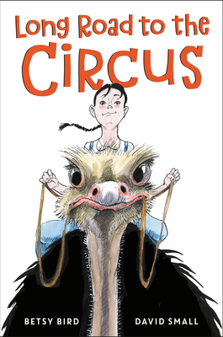
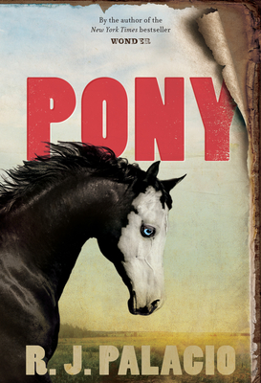
Historical Fiction
This One's Dedicated to ... 7 min. discussion for teachers
3 minute book trailer
What Parent's need to know at Common Sense Media
Notes:
Pony IL: 5-8, RL- September 28, 2021 Heard Raquel Jaramillo talk about her book. So much heart in this book about Silas and his adventure with the men who might have taken his father as well. Interesting “ghost” character who seemed to empower Silas and his “Pony”.
Long Road to the Circus Betsy Bird RL 5.4 810L– Story about Sally who wants to learn to ride the Ostrich “Goucho” on her excentric neighbors farm. Twelve-year-old Suzy Bowles dreams of life outside the small town of Burr Oak Michigan, but when she stumbles on the opportunity to learn ostrich-riding with the infamous Madame Marantette her obligations to her family on the farm threaten to derail her dreams of a bigger life. Includes photographs and information on Madame Marantette.

Slide 14
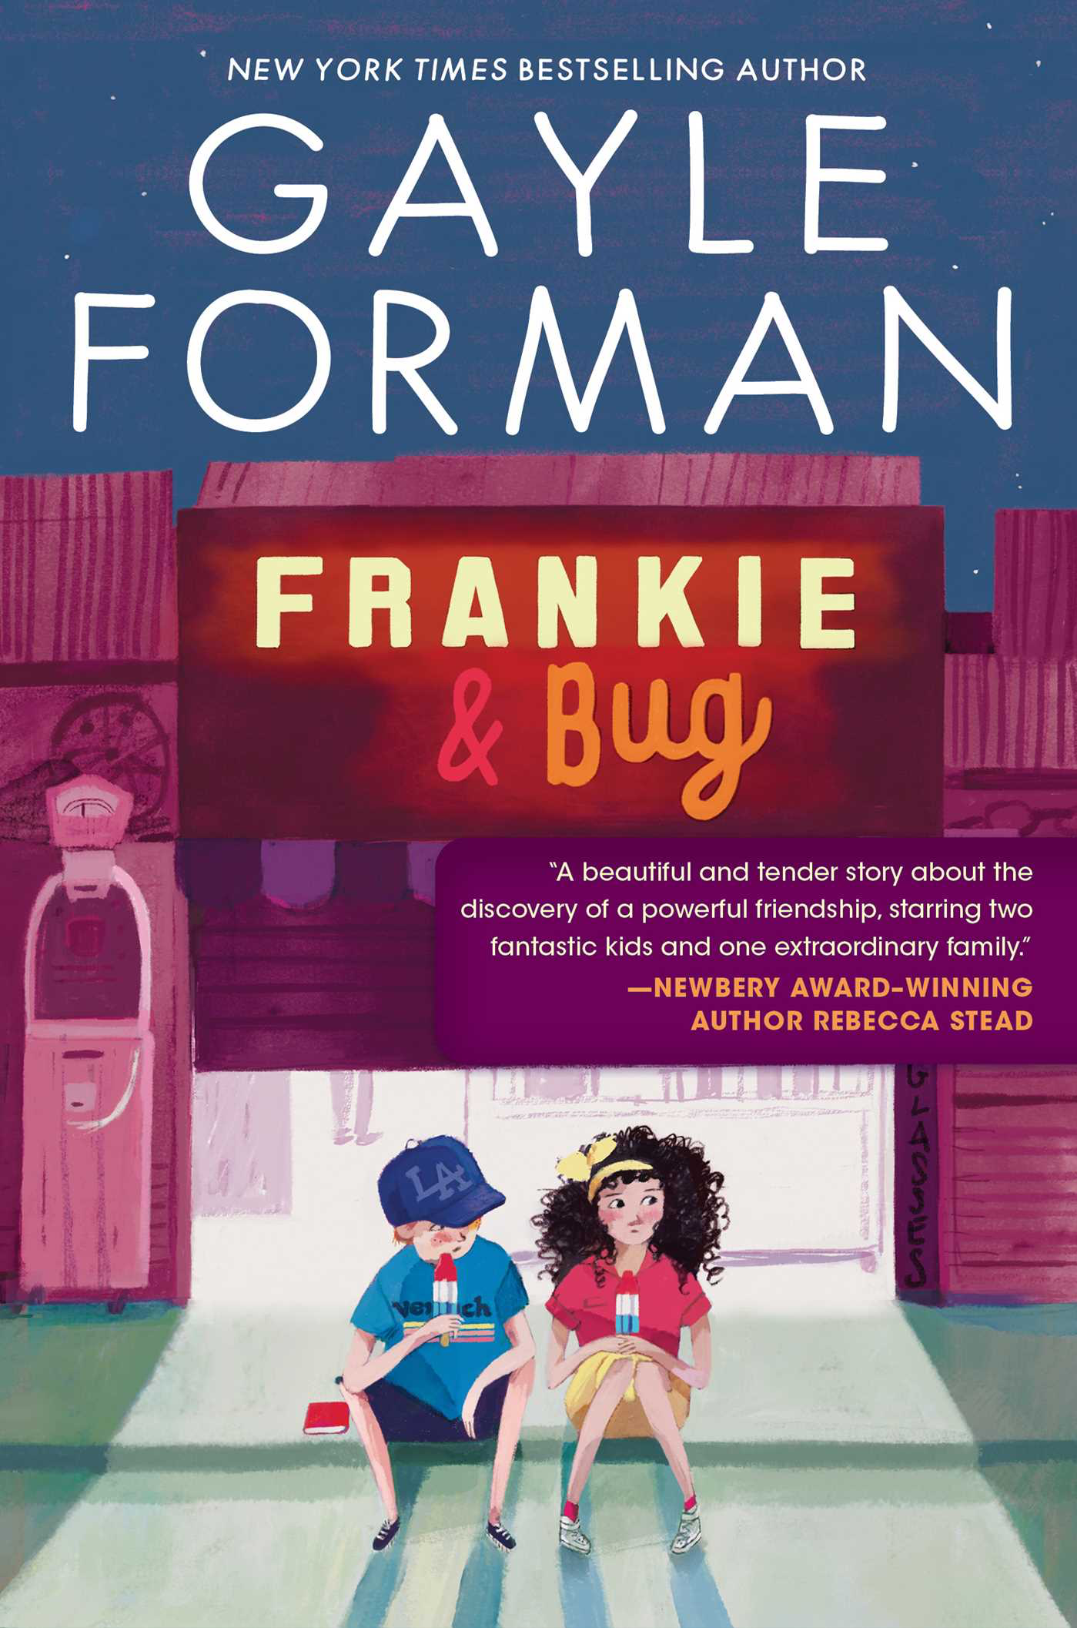
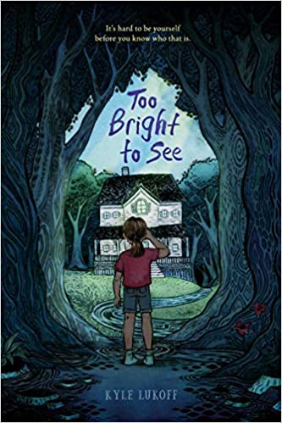
Main Character named Bug
“It’s about a kid being haunted by the ghosts of their dead uncle into figuring out something important! It’s kind of a scary story, and also a sad story but with a mostly happy ending, and it’s about figuring out how to make friends, being who you are, and letting go of someone you love.”
2 min. Kyle Lukoff as National Book Award Finalist
Simon & Schuster page with Reading Group Guide
2022 ALA Notable
Notes:
Too Bright to See – 4*, April 20, 2021 –Jonker/Schu #15, DPL Staff Favorites - LGBT – National Book Award Finalist – SLJ Best – Publisher says 12+
“It’s about a kid being haunted by the ghosts of their dead uncle into figuring out something important! It’s kind of a scary story, and also a sad story but with a mostly happy ending, and it’s about figuring out how to make friends, being who you are, and letting go of someone you love.”
Gender identity and death lovingly explored in spooky story.(Common Sense Media says 10+)
“In rural Vermont, Bug spends the summer preparing for middle school, grieving Uncle Roderick's death, and grappling with a ghost and gender identity.” ALA
Frankie and Bug – 2* October 12, 2021 – 700L GL 3-7 Summer vacation story. Bug wants to hang out at the beach with older brother Danny, but instead is stuck with neighbor Philip’s nephew, Frankie. Lots of lessons. Common Sense media gives it 4* age 11+ - ”complex ‘80s tale of trans tween. Author is not trans so that may be why it has not garnered the same affection as Too Bright to See. Audio Book read by Stockard Channing.

Slide 15
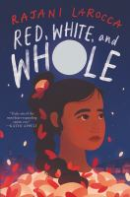
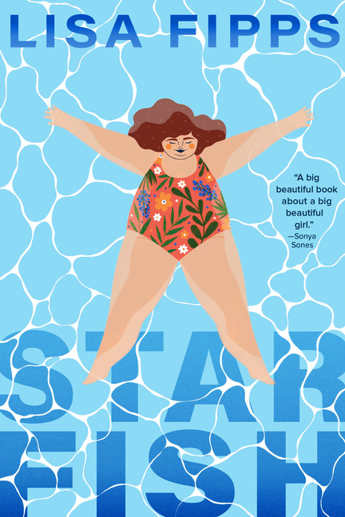
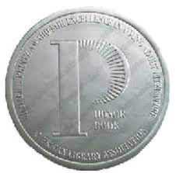
Novels in verse
2022 Michael L. Printz
Honor Book
The-One-Thing-You’d-Save Reader's Guide
2022Walter: Young Reader
2022 ALA Notable
Rajani LaRocca website
Starfish Discussion Guide at Random House
Lisa Fipps introduces her book 1 min.
2022 ALA Notable
Feb. 2
Red White and Whole Book Trailer 1 min.
Notes:
Starfish Int Lvl: 5-8; Rd Lvl: 4.7 March 9, 2021 DPL Staff Favorites, NCTE Charlotte Huck Award Honor Book 2022 Printz Honor Book, 4 stars, Jonker/Schu #4 SLJ Best
This Novel in Verse tells Ellie’s story about the bullying and other sufferings due to her size. Tackles the health care system as well.
“Ellie’s struggles to find her voice and self-worth unfold in verse as she stands up to those who bully and fat-shame her. ”ALA
The One Thing You’d Save 4*, IL: 3-6 RL: 3.9 NPR Best, DPL Staff Favorites March 16, 2021
A teacher asks the students in her diverse class what they would take if their house was on fire. Book for teachers and classrooms. Poetry is sijo (pronounced SHEE-zho) traditional Korean Poetry.
“Using traditional and modified sijo poetic structure, Park explores what children would save if they were ever in a housefire.” ALA
Red, White, and Whole Int Lvl: 3-6; Rd Lvl: 4.4 Jonker/Schu #3 SLJ Best,
Feb 2, 2021 DPL Staff Favorites, Written by physician Rajani LaRocca Set in 1983 America this #ownvoices novel in verse about an Indian American girl, Reha, whose life is turned upside down when her mother is diagnosed with leukemia. 2022 Walter Award Honor Book
“In this novel in verse set during the 1980s, Reha struggles with her cultural identity as an Indian American girl while coping with the realities of her mother’s leukemia.”ALA

Slide 16
Likes and Loves from the Literary Lists 2022 Marcie Haloin Session # 408 Friday, Feb. 11, 1:30-2:30

