Slide 1
Likes and Loves: Books to Empower Colorado Children 2023 Edition Junior Books
Session #159
February 9, 2023
1:30-2:30
www.mhaloin.com

Slide 2
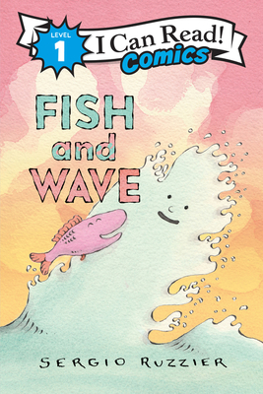
Beginning Readers
Sergio Ruzzier Website
Harper Collins page with acctivity page
5 min. author read aloud
Notes:
Gigi and Ojiji – 1*, Guided Reading L – Level 3 reader – Gigi’s Grandfather is coming from Japan to live with her and it may not be exactly as she anticipated, but in the end may all be good.
Fish and Wave – May 17, 2022 , 4*, Level 1 comic reader , Geisel Honor Book: Series includes Fish and Worm, Fish and Sun

Slide 3
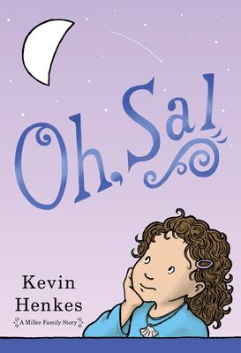
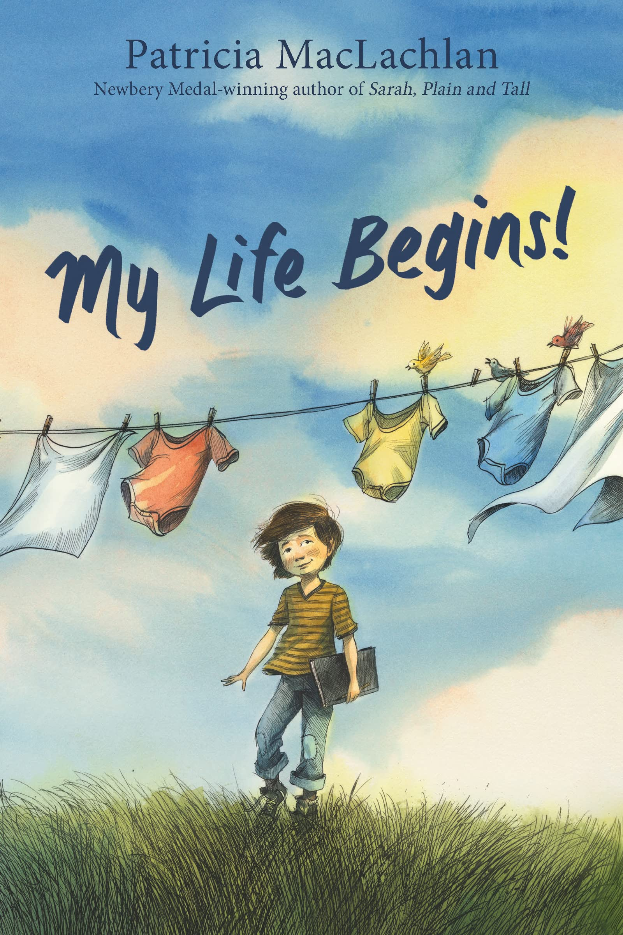
Chapter Books for Transitional Readers or Read-Aloud
August 2, 2022
Kevin Henkes Website
Colby Sharp 3 min. introduction on Youtube
HarperCollins Page with audio sample
Notes:
Oh Sal! December 14, 2021- Great Betsy Bird review, First chapter book inside the head of a 4 year old and taking place in 1 day. Third in the Year of Billy Miller (2014 Newbery Honor) Series. Four-year-old Sal cannot find a gift she recieved from Santa, her new baby sister still does not have a name and takes up all of Mama's attention, and her brother Billy is annoying, but Sal finds her own strengths over an eventful Christmas season with her family
My Life Begins! August 2, 2022 – 3*, Patricia passed March 31, 2022, almost 1 year ago. I will be spending this year rereading all her books. Lovely Danial Miyares illustrations. Sweet family read aloud, particularly around holidays.

Slide 4
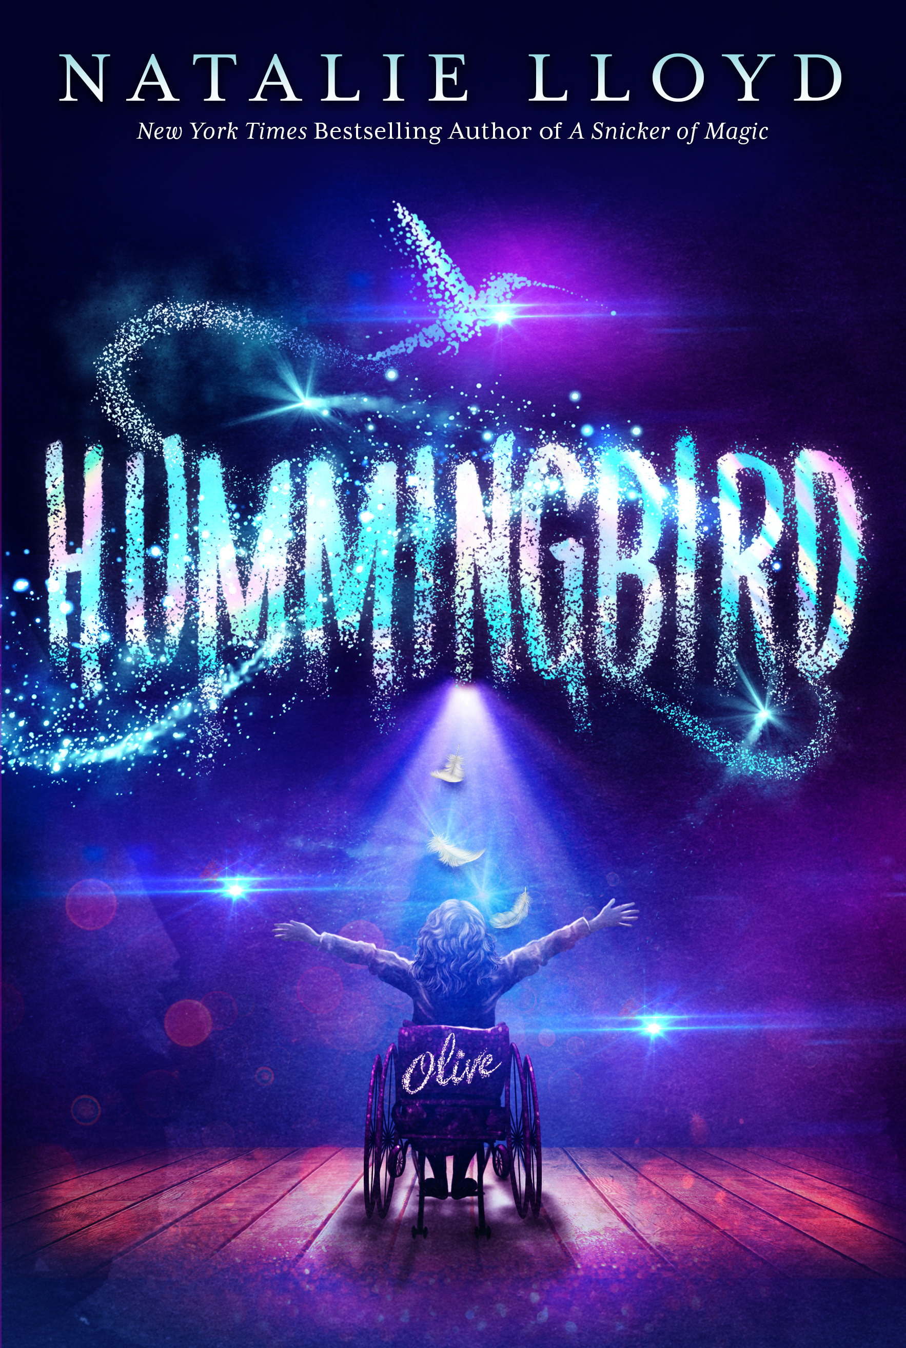
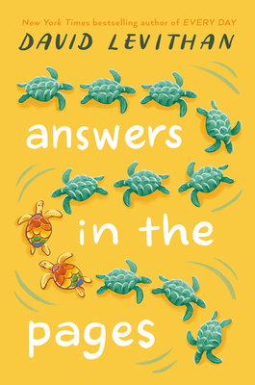
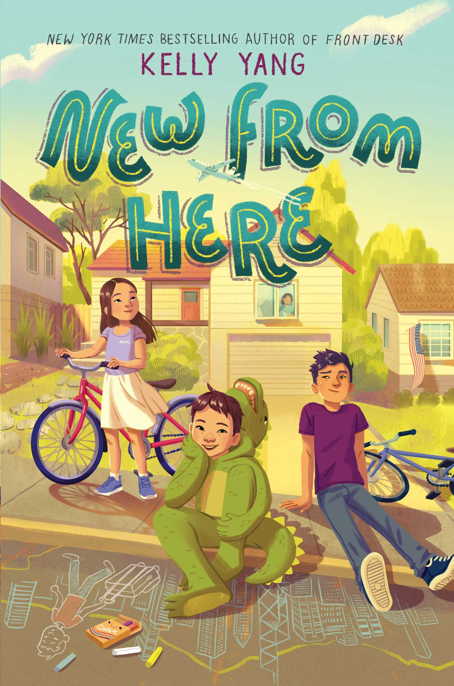
Contemporary Realistic Fiction
1 min Scholastic Bookfair Trailer
Kelly Yang website with author talk
2023 Schneider Family Book Award for Middle Grades
1 min. intro with Natalie Lloyd
Simon & Schuster with reading group guide
May 10, 2022
short book trailer on Youtube
Notes:
New From Here – 2*, RL 4.8 March 1, 2022 An Asian American boy fights to keep his family together and stand up to racism during the initial outbreak of the coronavirus. Based upon Kelly Yang’s family.
Hummingbird – 2*, Twelve-year-old homeschooled Olive is tired of being seen as “fragile” just because she has osteogenesis imperfecta (otherwise known as brittle bone disease) so she’s thrilled when she finally convinces her overprotective parents to let her attend Macklemore Elementary.
Answers in the Pages - 4*, RL4.7May 10, 2022, When Donovan left his copy of The Adventurers on the kitchen counter, he didn’t think his mom would read it—much less have a problem with it. It’s just an adventure novel about two characters trying to stop an evil genius. But soon the entire town is freaking out about whether the book’s main characters are gay, Donovan’s mom is trying to get the book removed from the school curriculum, and Donovan is caught in the middle. A bold, timely novel about speaking up and coming out as parents lobby to ban a beloved book from the school curriculum by New York Times-bestselling author David Levithan.

Slide 5
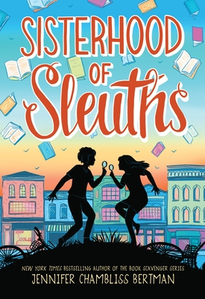
Contemporary Realistic and Historical Fiction Mystery
2023
Asian Pacific
Medal
Teaching Books.net resources
Not sure above link will work without a subscription
2023
Newbery
Honor
Lisa Yee's website
Feb. 1, 2022
Jennifer Chambliss Bertman website
Notes:
Maizy Chen’s Last Chance- RL4.6, 3*, National Book Award Finalist, Asian/Pacific American Medal, Newbery Honor – The story of a Chinese families immigration and opening of a Chinese Restaurant in Last Chance Minnesota (many parallels to the author’s family story but book is fiction)
Sisterhood of Sleuths – October 4, 2022, clever and thought-provoking mystery that pays homage to classic Nancy Drew stories, perfect for fans of Wendy Mass and Trenton Lee Stewart. When a box of old Nancy Drew books are left at the used bookstore, a mystery enfolds and the friends need to solve the mystery.

Slide 6
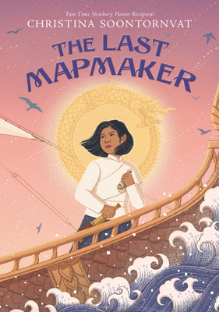
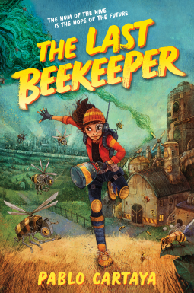
Fantasy
April 12, 2022
Harper Collins Link with audio sample
Christina Soontornvat Website
CommonSenseMediaLink to The Last Mapmaker
Christina Soontornvat Discusses the Last Mapmaker
To Change a Planet Picture Book by Christina Soontornvat
Notes:
The Last Mapmaker –April 12, 2022 RL 5.2, 4*s. Newbery Honor, Walter Honor from we need Diverse Books, Thai inspired middle grade fantasy has Sai joining an expedition to chart the southern seas, twelve-year-old mapmaker's assistant Sai, posing as a well-bred young lady with a glittering future, realizes she's not the only one on board harboring secrets when she discovers the ship's true destination. Soontornvat has had such an amazing year. Link to her 2021 picture book To Change A Planet.
The Last Beekeeper – July 12, 2022 1*, dystopian science adventure where Yolanda Facing a world dually altered by climate change and those who profit from it, Yolanda Cicerón will have to fight to save the last known beehive from extinction in this stirring new adventure by award-winning author Pablo Cartaya.

Slide 7
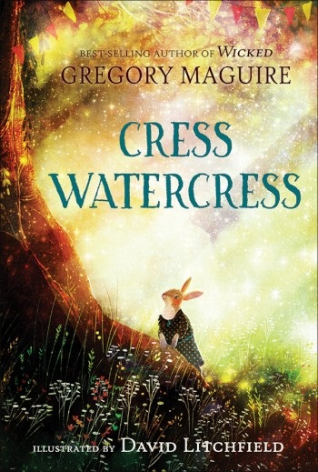
Fantasy/Animals
ALA Notable Middle
Harper Collins page with teacher's guide
Teaching Guide from Candlewick
Very short trailer at Book Riot
1 min. trailer by Candlewick Press
2 min. intro by Gregory Maguire
Notes:
Cress Watercress, 3*, IL3-6; RL4.2, Well written rabbit fantasy reminiscent of Watership Down and Wind in the Willows. Beautifully illustrated by David Litchfield. Not sure why this amazing book did not garner more recognition, but possibly because of the prominence of the author. The book is rife with similes and metaphors, and the chapters are short, which makes it a wonderful read-aloud. It is a tale of moving on, while remembering the past. —The Denton-Record Chronicle
Violet and Jobie in the Wild, 5*, RL 4.3 Violet and Jobie, sibling mice accustomed to living comfortably in a human home, find themselves uprooted and must quickly adapt to an unfamiliar world”. The humor, heart, and great use of figurative language make this a fun read aloud as the mice encounter, interact, and connect with many woodland animals. Teacher’s guide at HarperCollins

Slide 8
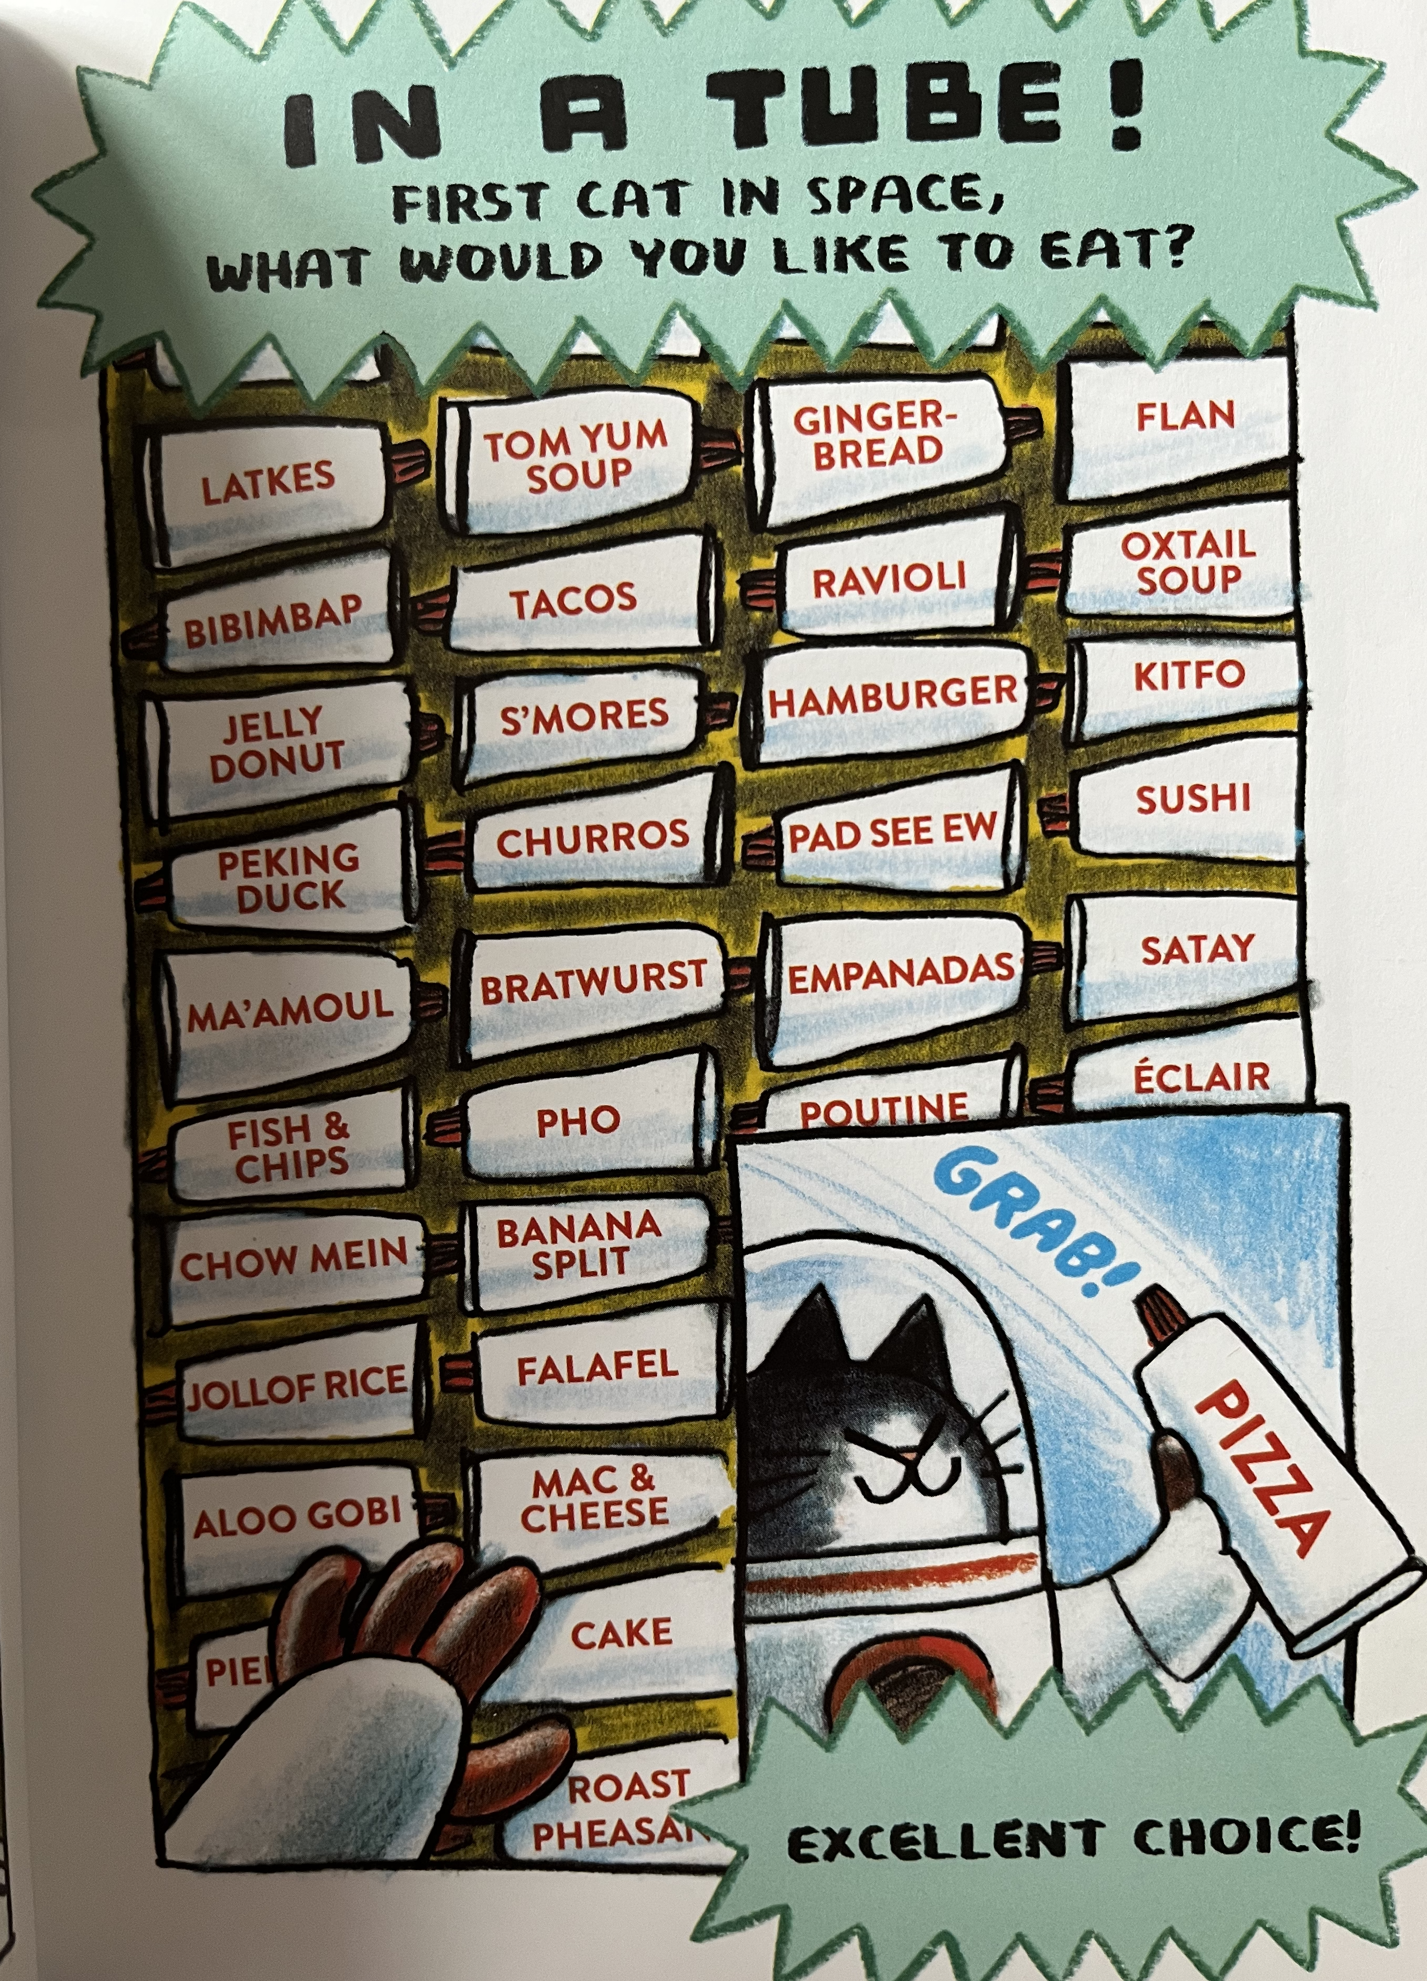
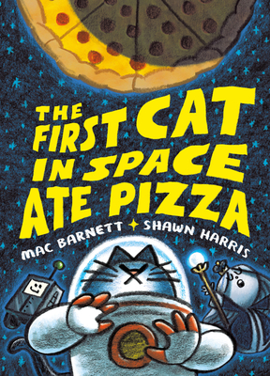
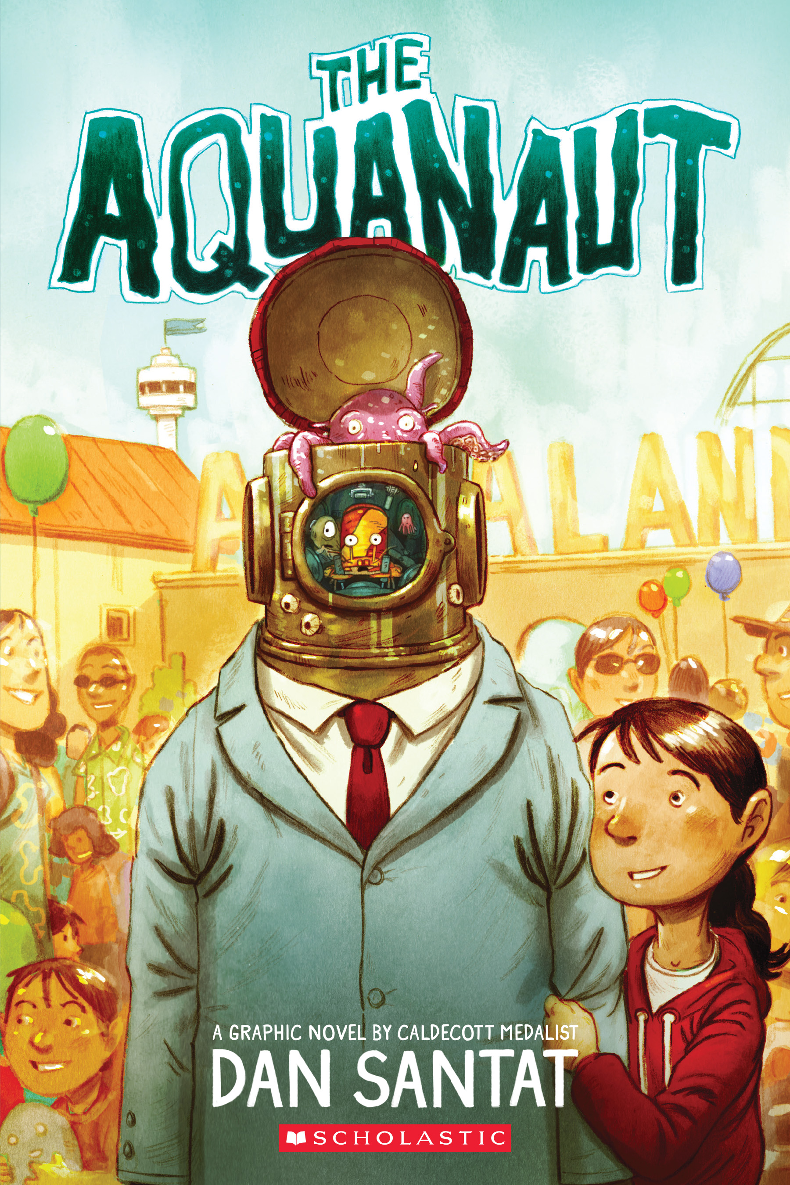
Graphic Novels
1 min. Scholastic booktalk by Dan Santat
https://www.thefirstcatinspace.com/
Notes:
First Cat in Space Ate Pizza – 3*, May 10, 2022 , Story of food page and how I spent summer finding restaurants and food trucks in Denver representing each kind of food. Didn’t find a couple but fun research.
The Aquanaut – 1*, 270L, March 1, 2022, Ever since her father was lost at sea, Sophia has been moping around Aqualand, the marine theme park her dad and uncle created. But Sophia's world is turned upside down when an "aquanaut" breaks into the park's research lab.
Frizzy- 5*, 430L, October 18, 2022.

Slide 9
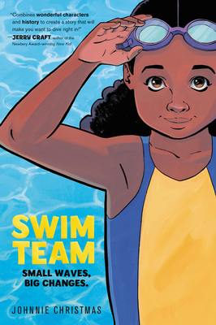
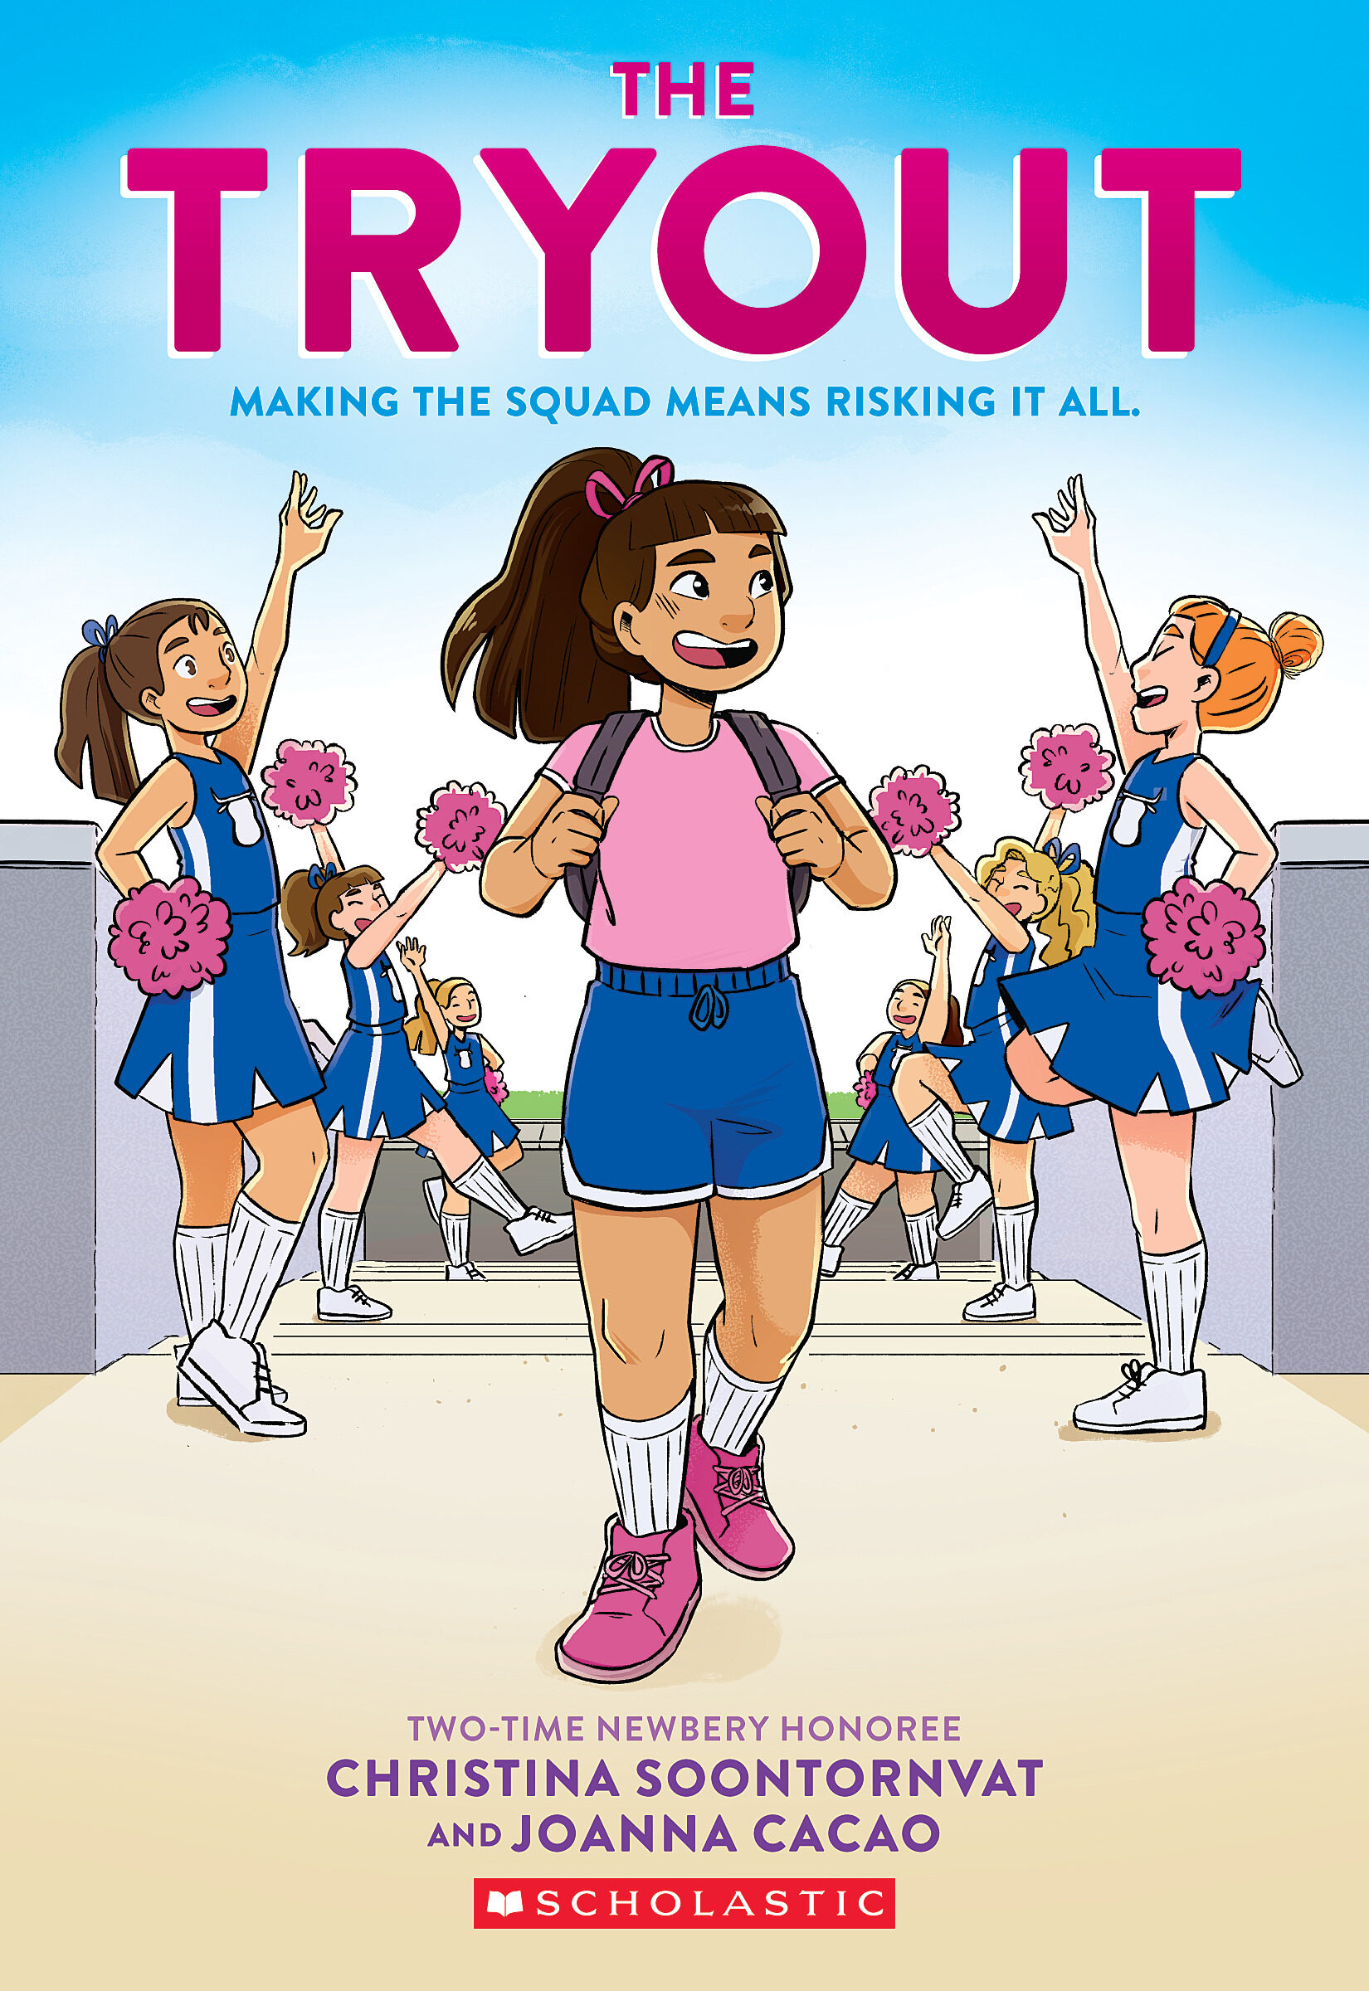
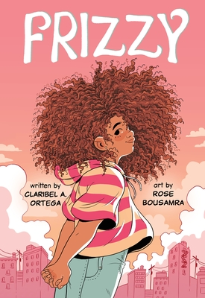
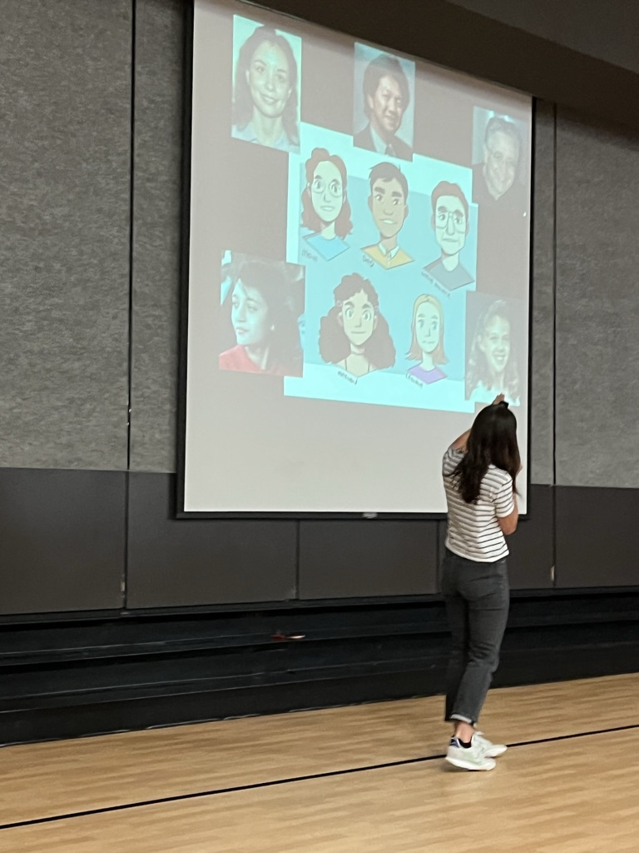
Graphic Novel/Memoir
Clarabel A. Ortega Website
4 min. introduction with Christina Soontornvat
ALA Notable Middle
Johnnie Christmas Website
Notes:
Swim Team: Small Waves, Big Changes – 3*, RL3.7, Jane Adams B.A. Honor Johnnie Christmas’ The only open class in Bree’s new Florida MS is Swim 101. Although she can’t swim Bree is helped by elderly neighbor Etta. Explores the history of discrimination in swimming and acess to pools,. A powerful, knowledgeable, and pressing exploration of the intersection where swimming meets Black identity
The Tryout: Making the Squad Means Risking It All – 2*, RL 5.2 – Joanna Cacao illustrated based upon photos of the real children in this graphic memoir of Soontronvat’s 7th grade cheerleader tryouts.
Frizzy – 5*, 430L, Marlene hates the weekly trips to straighten her frizzy hair, but with the help of her friend (at her cousins Quince) and aunt she learns to appreciate her curls and repair her relationship with her mom.

Slide 10
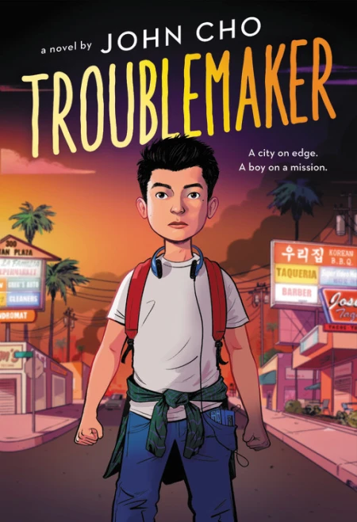
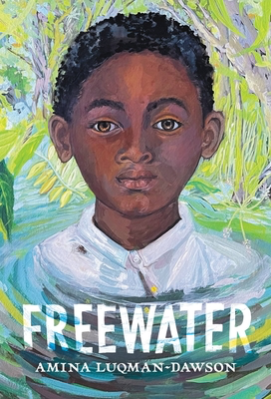
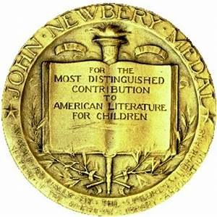
Historical Fiction
2023 Coretta Scott King Author Award
2023 Newbery Medal
Author's name at Teaching Books.net
2023
Asian Pacific
Honor Book
1 min. booktrailer by Amina Luqman-Dawson
Notes:
Freewater- February 1, 2022 – 5*, Debut author Amina Luqman Dawson pens a lyrical, accessible historical middle-grade novel about two enslaved children's escape from a plantation and the many ways they find freedom.- loosely based on the history of maroon communities in the South, this is a striking tale of survival, adventure, friendship, and courage.

Slide 11
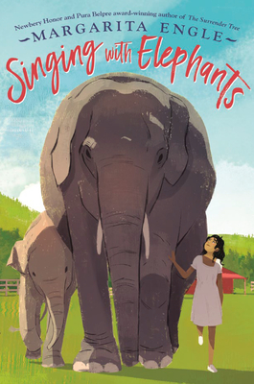
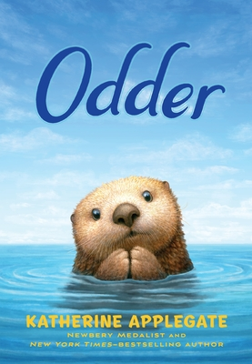
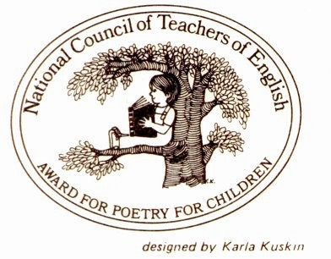
Novels in Verse
ALA Notable Middle
15 min. The Yarn podcast with Colby Sharp and Katherine Applegate
Penguin Random House Book Page
2023 NCTE Notable Verse Novel
Notes:
Odder – 2*, RL 5.6, A 2023 Notable Verse Novel, National Council of Teachers of English (NCTE) - Based on the Monterey Bay Aquarium and its otter rescue and fostering program this is a free verse tribute to Otters. Beautiful Charles Santoso black & white illustrations.
Singing with Elephants – May 31, 2022 RL5.7, Oriol whose family came from Cuba to California to run a clinic to care for injured animals. She strikes up a friendship with Gabriela Mistral, the first Latin American winner of the Nobel Prize in Literature. Together they find a way to help and elephant left in their care. Author’s note and resource bibliography included.

Slide 12
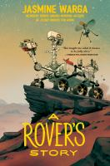
Science Fiction
Harper Collins with link to Teacher's Guide
ALA Notable Middle
7 min. Jasmine Wagra reads and introduces the book for Woman's History Month
4 minute booktalk by Colby Sharp
Notes:
A Rover’s Story: 3*’s, October 4, 2022, RL 6.1, Alternating points of view and letters tell the story of Res, a Mars Rover who begins to develop human feelings. The NASA scientists who assemble him and their families become part of the story.

Slide 13
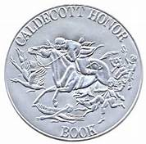
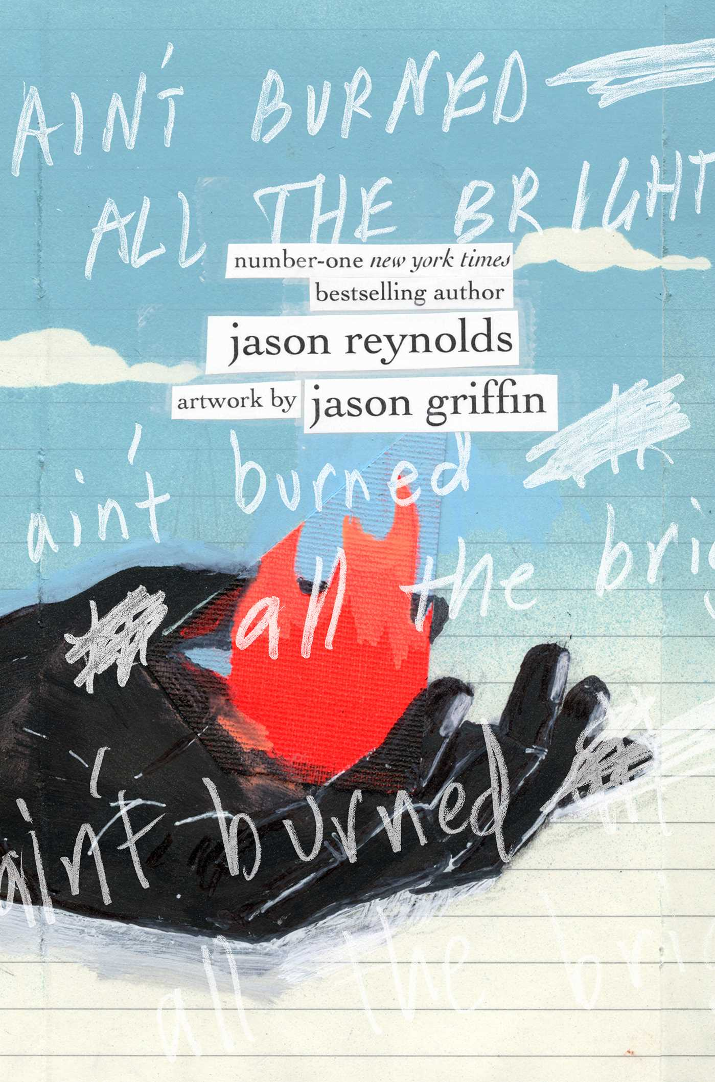
Teen/Young Adult
2023 Caldecott
Honor Book
ALA Notable Older
2022 Boston Globe
Horn Book Award Picture Book
Publisher website with author interviews
Publisher page at Simon & Schuster
Teacher's guide from Simon & Schuster
Notes:
Victory Stand: Raising My Fist for Justice- September 27, 2022 – 4*, 2023 YALSA Excellence in Non-Fiction, Coretta Scott King Author Award and Illustrator Honor Book, National Book Award finalist, Horn Book Fanfare - Story of Tommie Smith and John Carlos who raised their black gloved fists at the 1968 Olympics to protest racial injustice inflicted upon African Americans. The book looks back on all that led up to that event and the consequences for Tommie’s future.
Ain’t Burned All The Bright –8* January 11, 2022 – RL 5.2, 2023 Caldecott Honor Book, 2022 Boston Globe Horn Book Award Picture Book. A smash up of art and text that viscerally captures what it means to not be able to breathe, and how the people and things you love most are actually the oxygen you most need.

Slide 14
What follows is 10 CCBA 2023 Junior Book Nominees with links to their book trailers

Slide 15
vote at CCIRA.org→Professional Learning-->Colorado Children's Book Award
Nominated books must be currently in print and published in the five years preceding the award year.
Only one title per author will be included in each year's ballot.
Last year's WINNING authors are not eligible this year.
Books previously nominated are not eligible for nomination in following years.
A book title nominated by more that one school or library will be considered more heavily for inclusion in the final list.
Books based on movies, television shows, toys, video games, or apps are not eligible for nominations unless the book preceded the movie or production.
The author of a nominated book must be a living author.
Caldecott and Newbery Award books are not eligible. Honor books are eligible.
Once a book in a series has won, all other books in that series by that author will not be eligible for nomination.
Children may vote for one picture book and one junior book provided they have read a minimum of three books in each category.
Submit the top 20 BOOK TITLES NOMINATED by children the CCBA Committee by March 1, 2023.
PLEASE be sure to put the number of students who nominated the book.

Slide 16
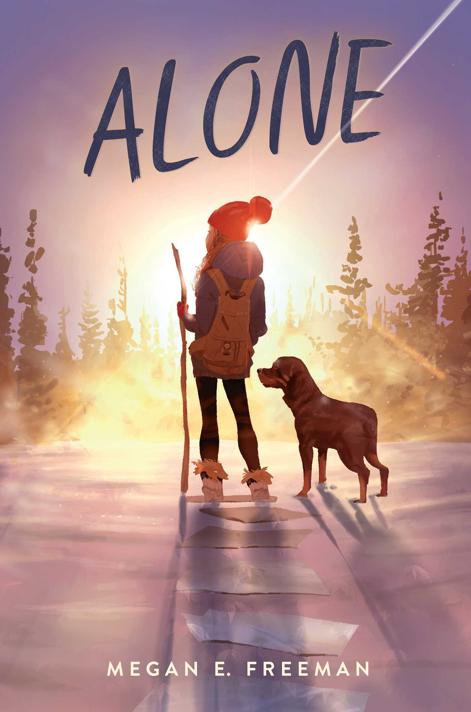
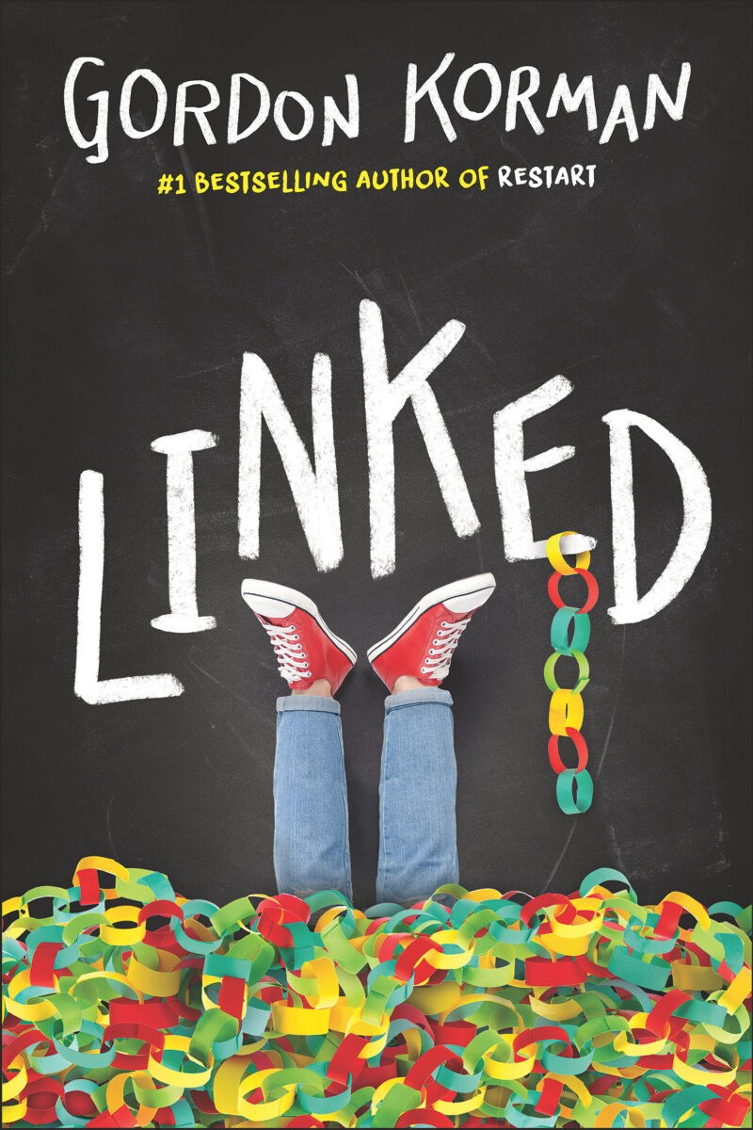
Books set in Colorado
Alone inroduction at Simon & Schuster
Gordon Korman's Website
Notes:
Alone RL 4.7 690L
When twelve-year-old Maddie hatches a scheme for a secret sleepover with her two best friends, she ends up waking up to a nightmare. She's alone--left behind in a Colorado town that has been mysteriously evacuated and abandoned. With no one to rely on, no power, and no working phone lines or internet access, Maddie slowly learns to survive on her own. Her only companions are a Rottweiler named George and all the books she can read. After a rough start, Maddie learns to trust her own ingenuity and invents clever ways to survive in a place that has been deserted and forgotten. As months pass, she escapes natural disasters, looters, and wild animals. But Maddie's most formidable enemy is the crushing loneliness she faces every day. Can Maddie's stubborn will to survive carry her through the most frightening experience of her life?
Linked RL5.3, 750L
Link, Michael, and Dana live in a quiet Colorado town. But it's woken up very quickly when someone sneaks into school and vandalizes it with a swastika. Nobody can believe it. How could such a symbol of hate end up in the middle of their school? Who would do such a thing? Because Michael was the first person to see it, he's the first suspect. Because Link is one of the most popular guys in school, everyone's looking to him to figure it out. And because Dana's the only Jewish girl in the whole town, everyone's treating her more like an outsider than ever. The mystery deepens as more swastikas begin to appear. Some students decide to fight back and start a project to bring people together instead of dividing them further. The closer Link, Michael, and Dana get to the truth, the more there is to face--not just the crimes of the present, but the crimes of the past.

Slide 17
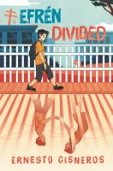
Fictionalized Memoir
Trailer at Book Tastings
1 min intro by Rob Harrell
4 min. intro by Ernesto Cisneros
Notes:
Wink, RL3.9 580L, 3*, When twelve-year-old Ross is diagnosed with a rare form of eye cancer, he just wants things to be normal. But he soon discovers normal is overrated, and that with music, art, and the support of his true friends, he can make it through his treatments and middle school.
Efren Divided , RL 4.7. 710L
"While his father works two jobs, seventh-grader Efrén Nava must take care of his twin siblings, kindergartners Max and Mia, after their mother is deported to Mexico. Includes glossary of Spanish words”

Slide 18
Historical Fiction
Andy Marino's website
1 min. book trailer at Scholastic
Notes:
Escape from Chernobyl – RL5.6, MG+ Two young siblings flee the Chernobyl disaster with their parents, but the Communist party is on their heels. Meanwhile, the friends and family they were forced to leave behind must contend with a disinformation campaign that's determined to pretend nothing is wrong-even as deadly radiation spills into the air.

Slide 19
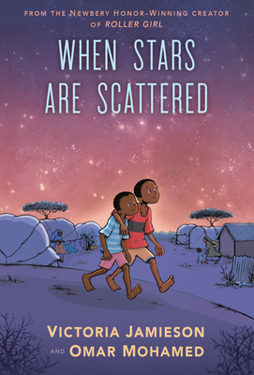
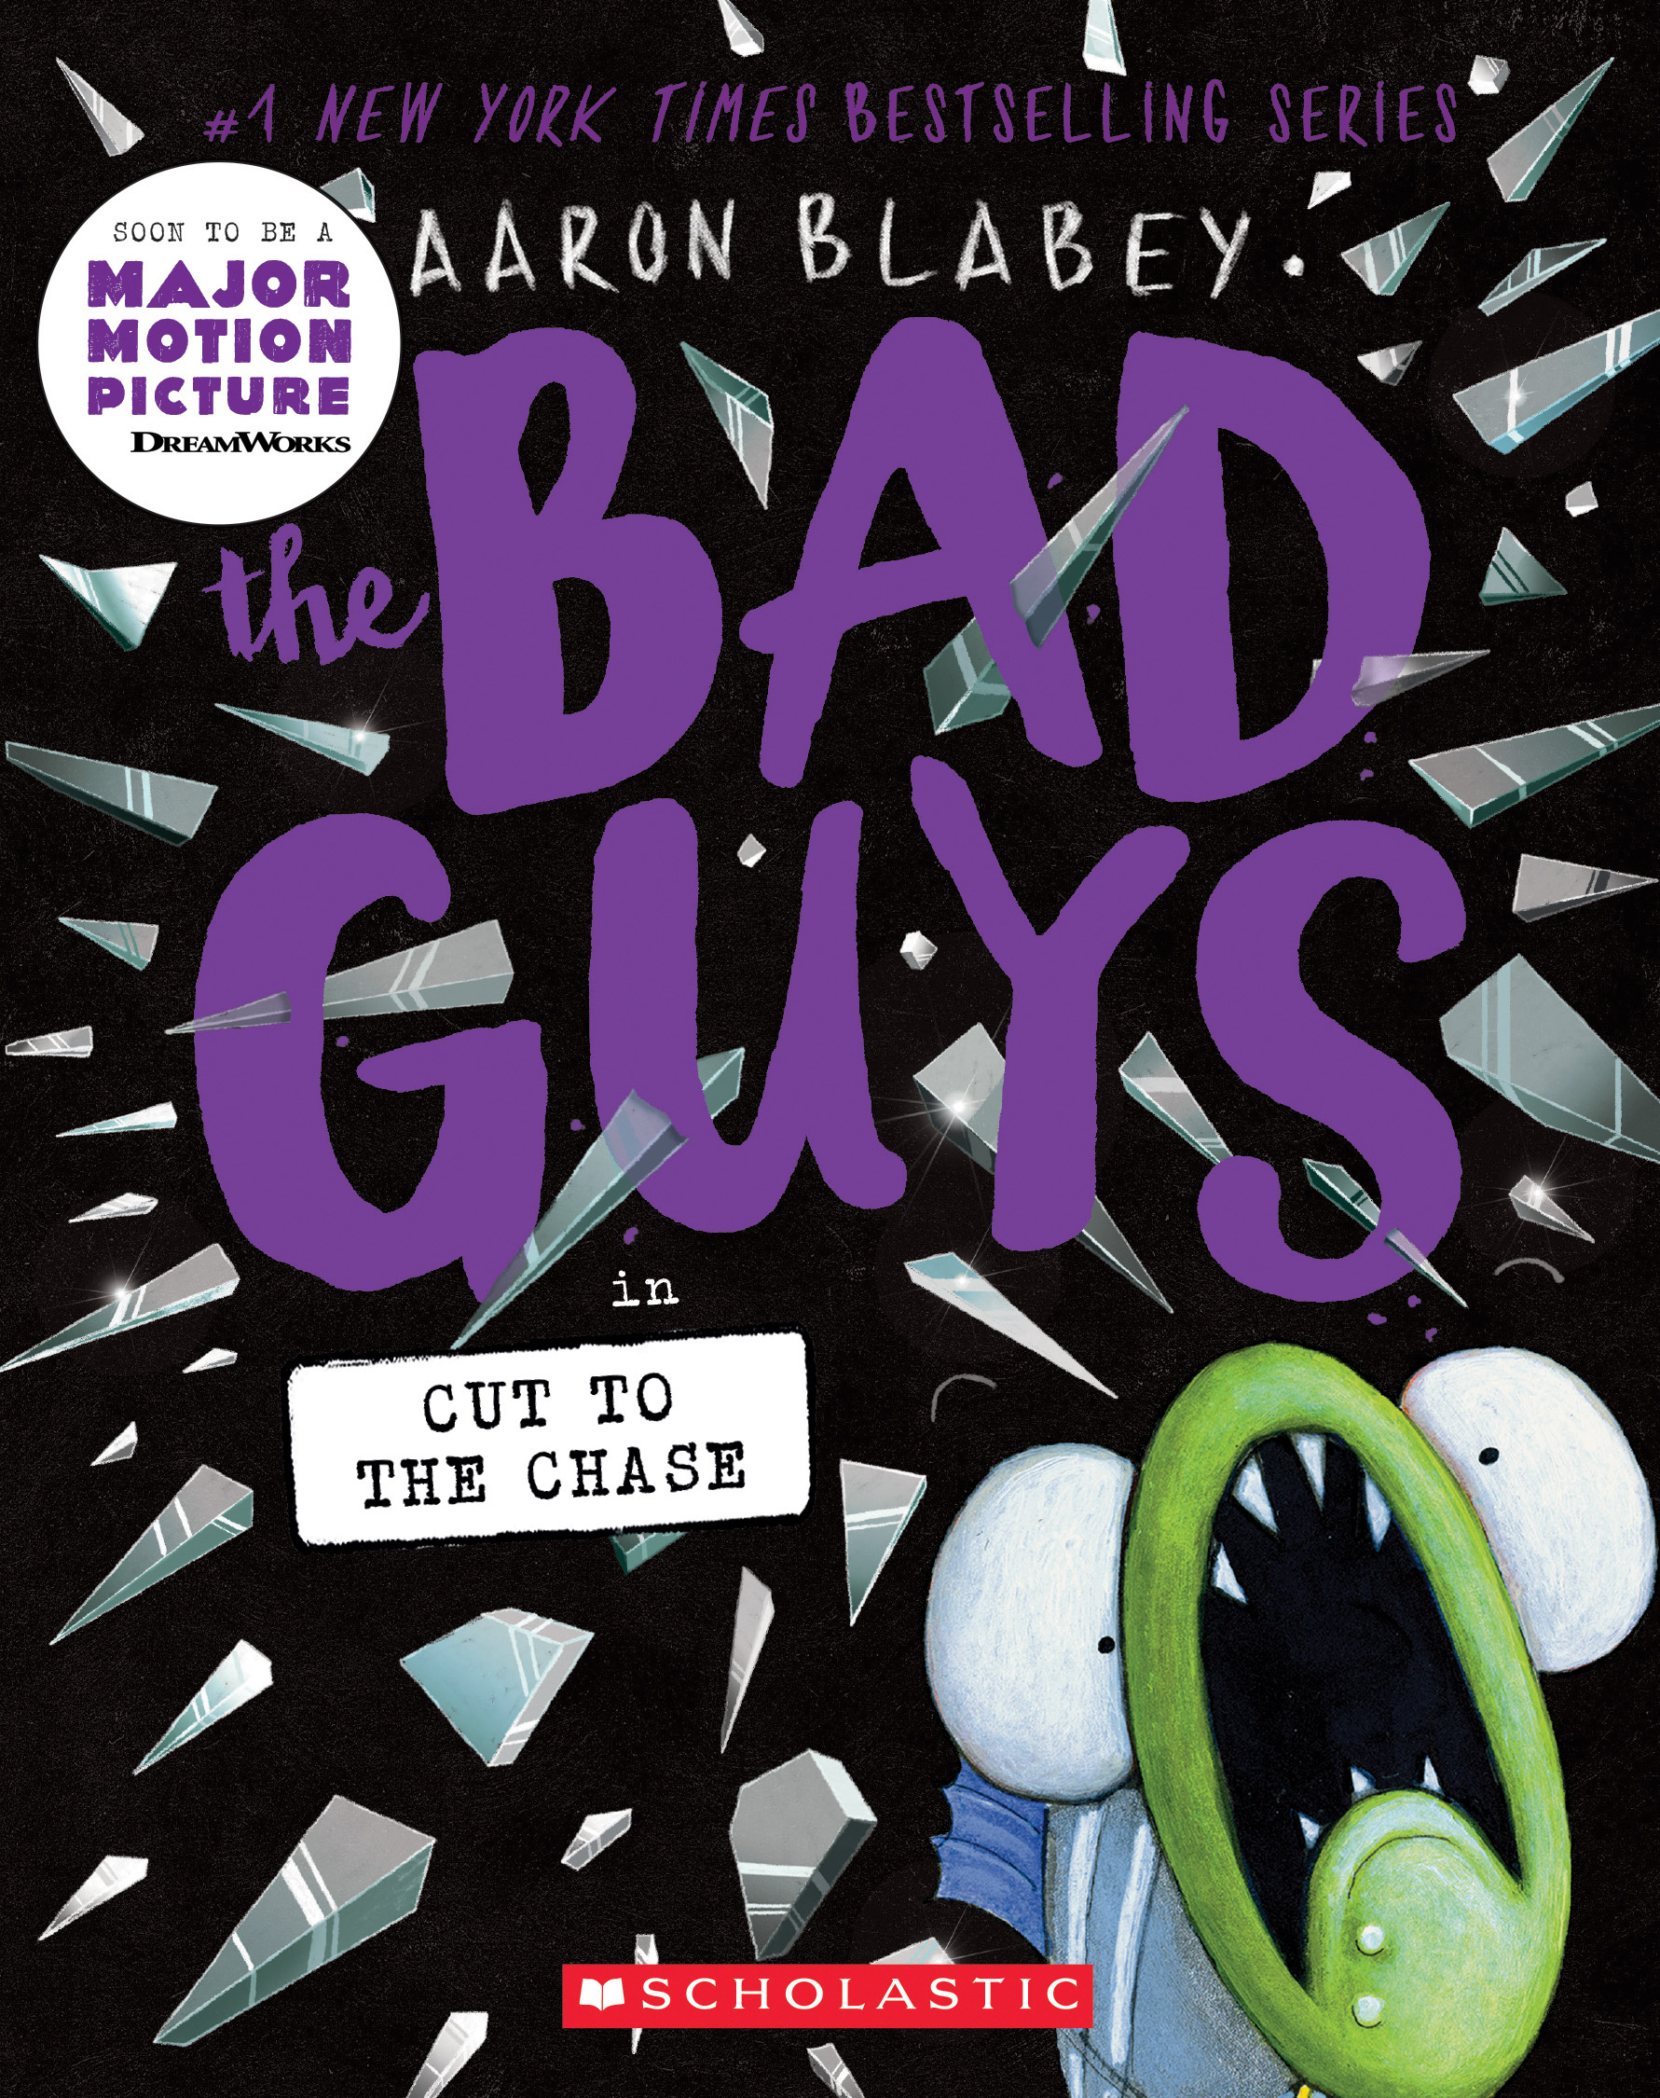
Graphic Books
20 min. read aloud by Reading Allowed Teacher
1 min. trailer at Penguin Middle School
Link to a pdfread of book is in notes full 198 pages
Penguin Random House teacher's guide
Notes:
When Stars are Scattered 3.7RL, 530L Graphic Novel
remarkable graphic novel is about growing up in a refugee camp, as told by a former Somali refugee to the Newbery Honor-winning creator of Roller Girl.’
Bad Guys # Cut to the Chase – 2.4RL, Graphic Novel, Movie not yet out when nominated
https://www.pdfread.net/ebook/the-bad-guys-in-cut-to-the-chase-aaron-blabey/
Full pdf 198 pages

Slide 20
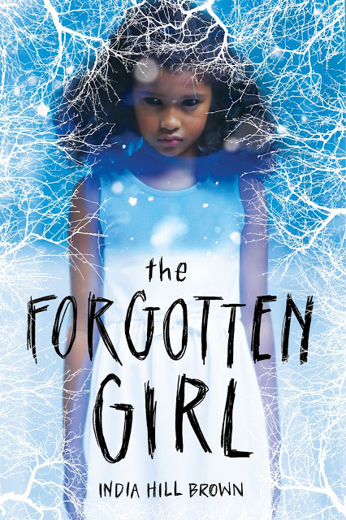
Ghost Story
Second 1 min. Scholastic Bookfair Trailer
Scholastic Bookfairs Preview 1 min.
Notes:
Forgotten Girl, RL 4.7, 670L – Daniel and Iris while investigating the local graveyards discover the neglected and forgotten Black cemetery and disturb a Avery, a jealous and demanding ghost.

Slide 21
Humor
1 min. intro by Jason Reynolds
30 second trailer Scholastic Bookfairs
Notes:
It’s the End of the World and I’m in my Bathing Suit – 5.6 RL When the electricity goes out, twelve-year-old Eddie and his friends set out to investigate what is going on when they make the startling discovery that they are the only ones left in their neighborhood--and perhaps the only people left anywhere.

Slide 22
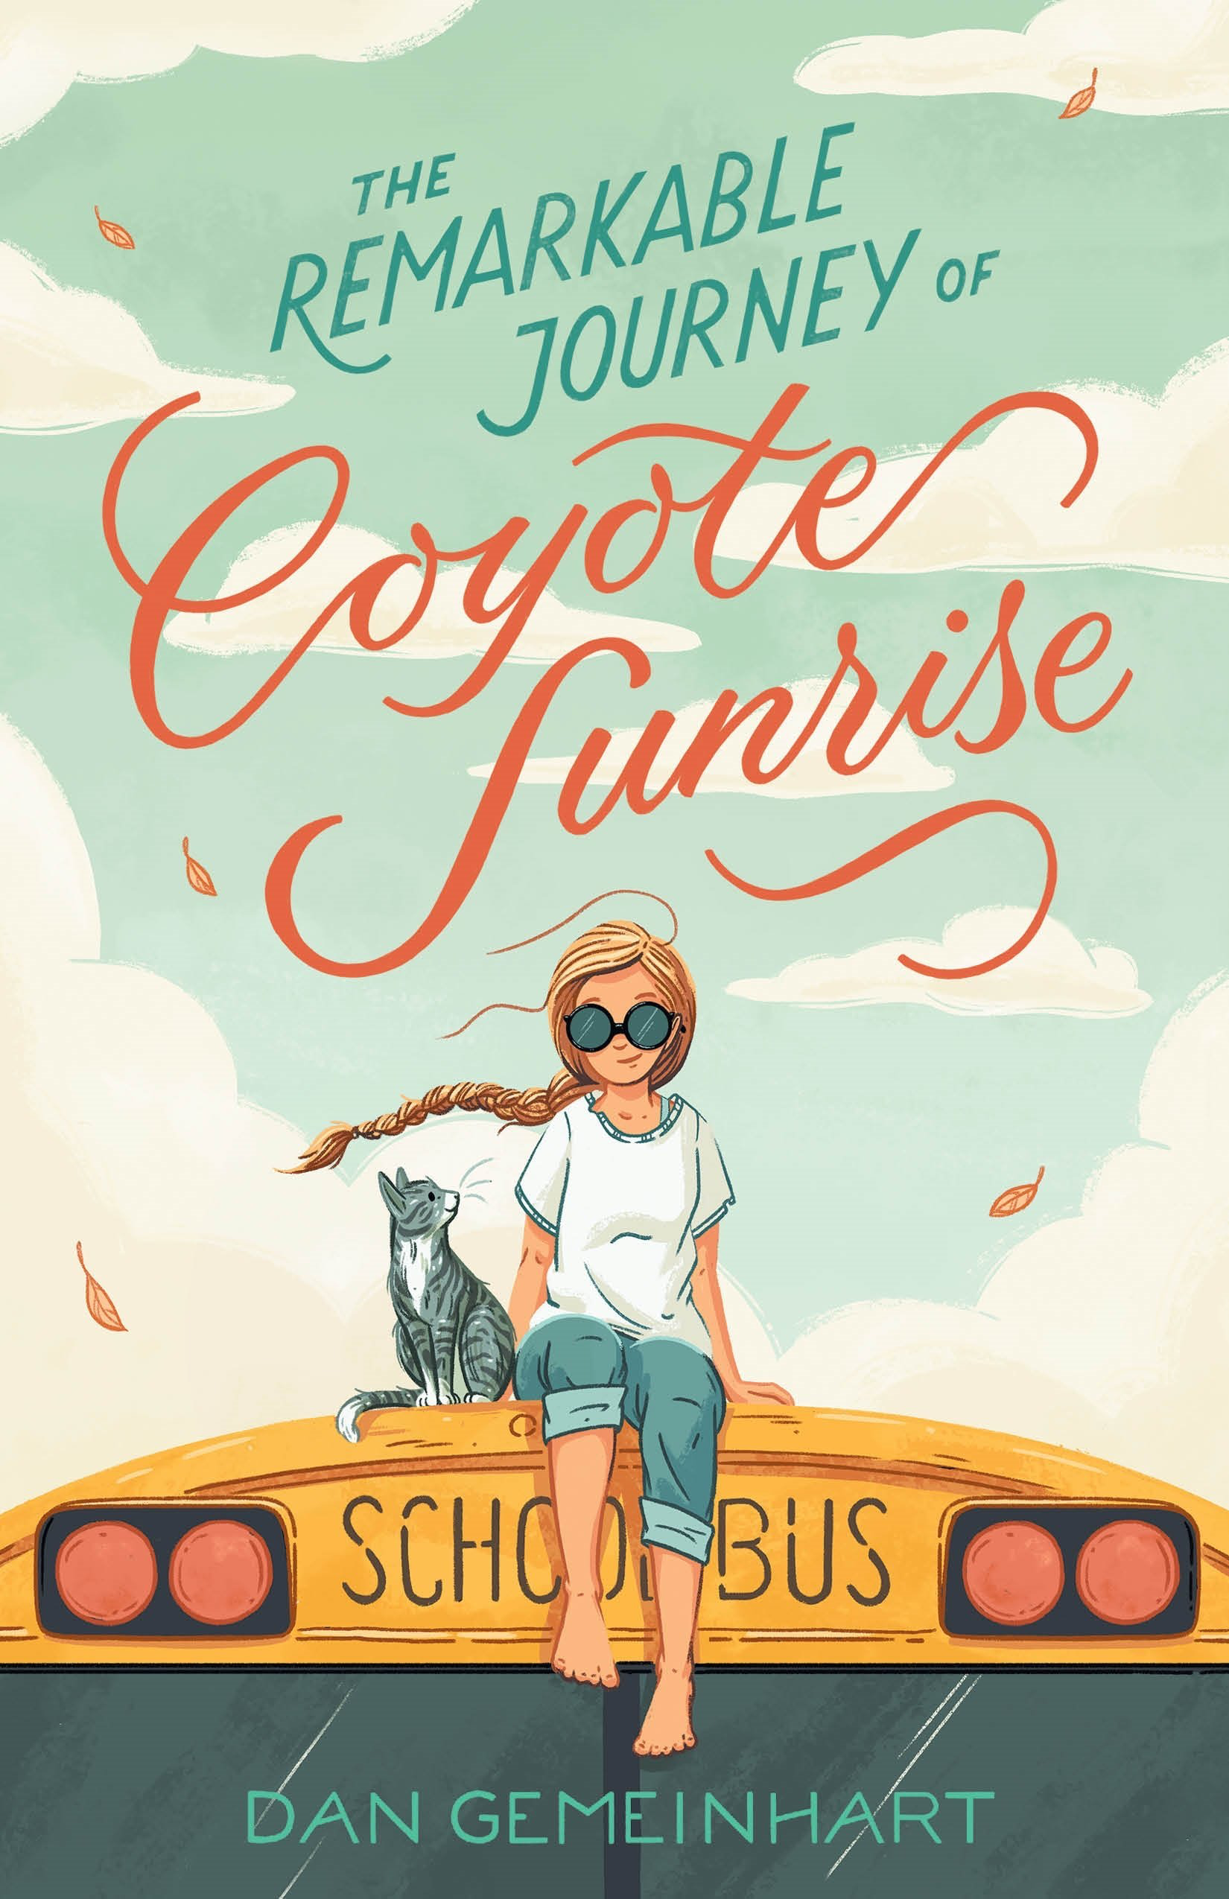
Adventure
Macmillan with links to trailers and guides
Notes:
Coyote Sunrise, RL 4.7, 730L, Twelve-year-old Coyote and her father rush to Poplin Springs, Washington, in their old school bus to save a memory box buried in a park that will soon be demolished.

Slide 23
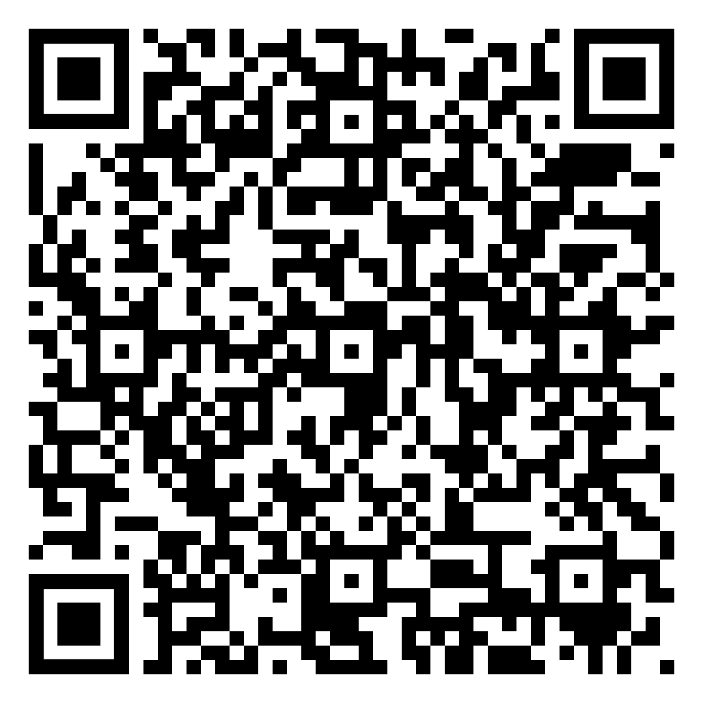
Likes and Loves: 2023 Marcie Haloin Session # 159 Thursday, Feb. 9, 2023 1:30-2:30
Notes:
Please take a moment to fill out an evaluation for this session.

Slide 24
Download this slide show and other resources for CCBA at
www.mhaloin.com
Have a great
Schoolyear!

