Slide 1
The Night Before Christmas
Strange Collection for a nice Jewish Librarian
Marcie Haloin, 2015
www.mhaloin.com

Slide 2
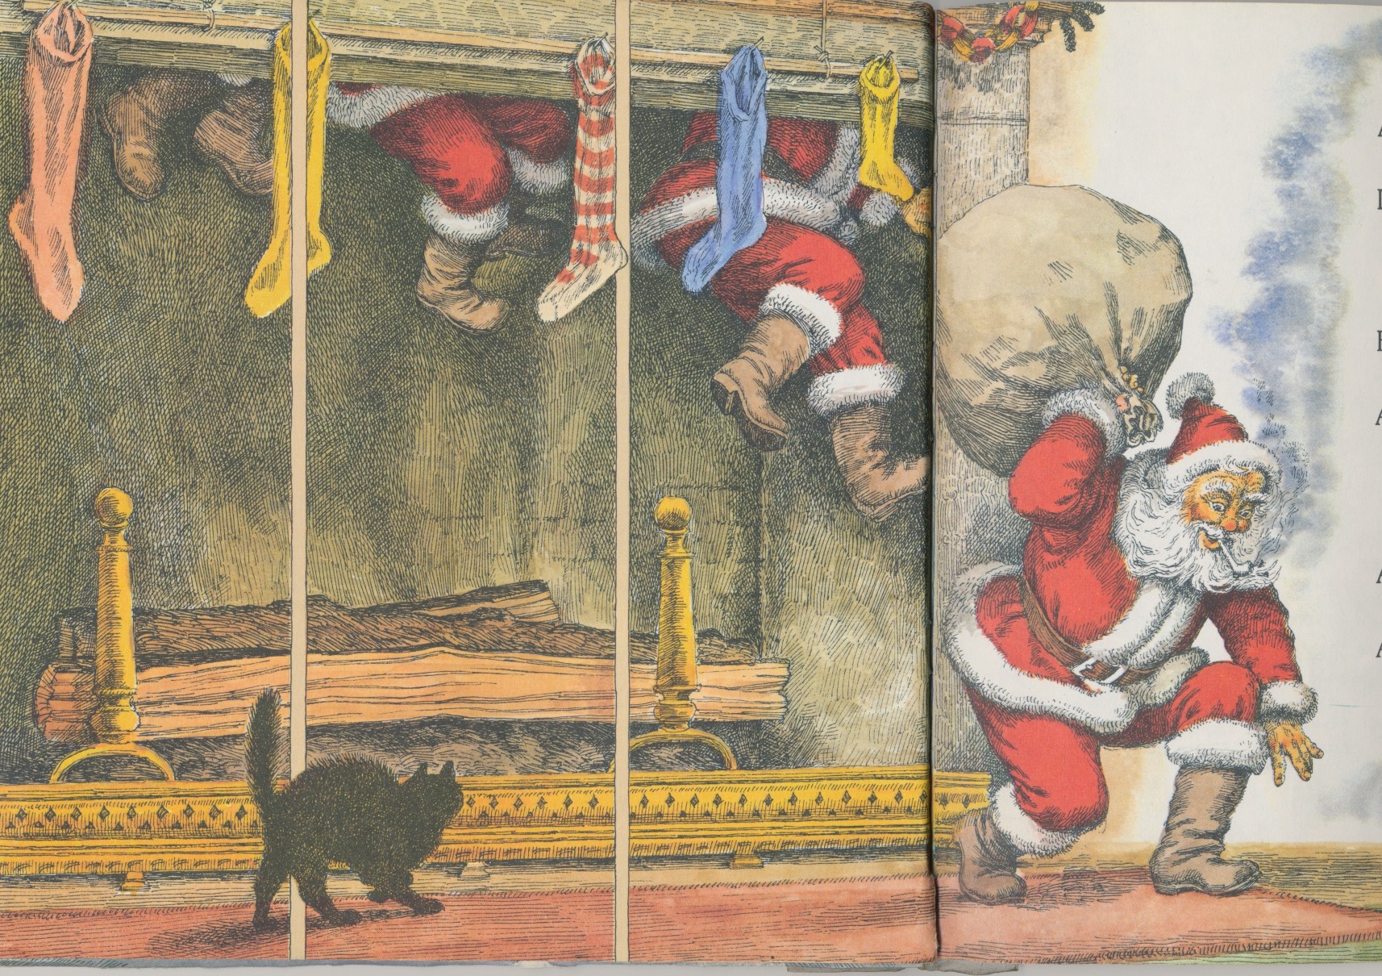
1976 #1

Slide 3
Green DOT means picture book with original poem.
For this Powerpoint whenever there is information in black or white font the text is Clement Moore’s poem.

Slide 4
Red dot means variation based upon the poem
For this Powerpoint whenever there is information in red font the text is a parody or variation, not the original poem.

Slide 5
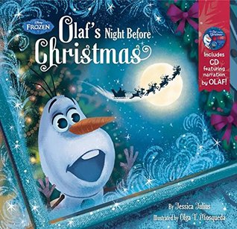
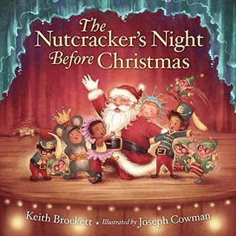
2015
Olaf’s Night Before Christmas, #194
Nutcracker’s … , #193

Slide 6
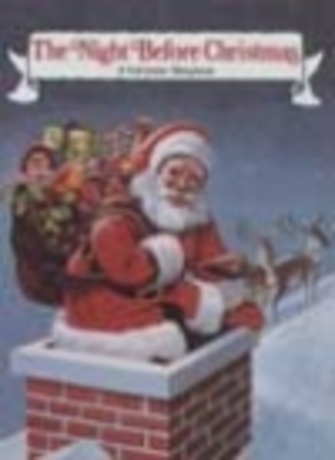
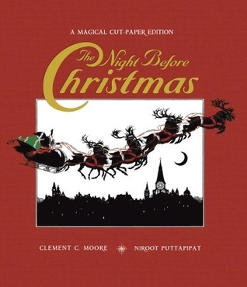
Big Books
Illustrated by Paul Johnson, #43, 1990
Magical Cut Paper Edition, #173, 2007
Big Book, #40, 1988

Slide 7
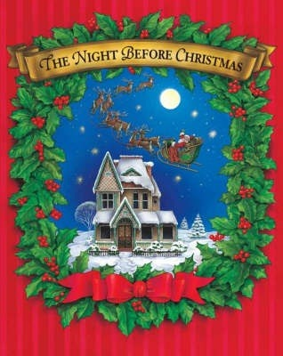
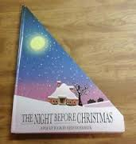
Triangle Pop-up, #53, 1992 Velvet Cover #169, 2006
#169, 2006 with CD recording

Slide 8
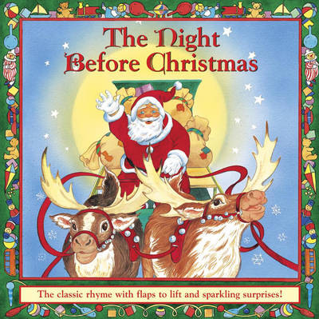
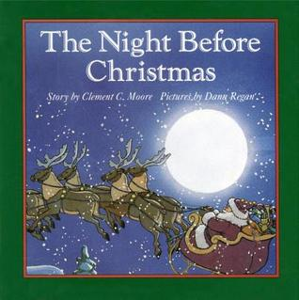
Board Books
#48, 1991 #117, 1997
Lift the flaps and sparkling surprises, #166, 2005

Slide 9
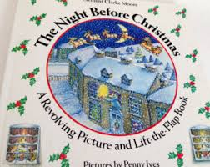
Penny Ives Revolving Picture and Lift the Flap
#7, 1988

Slide 10
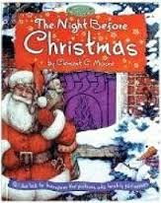
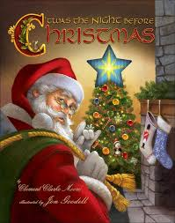
Magic Windows, #146, 2003 AniMotion, #181, 2009

Slide 11
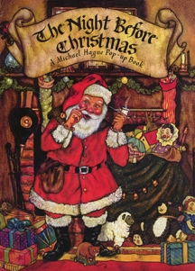
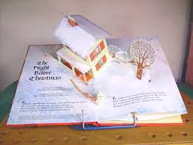
Michael Hague Pop-up #28, 1981

Slide 12
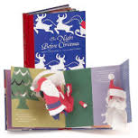
Robert Sabuda Pop-Up, #138, 2002

Slide 13
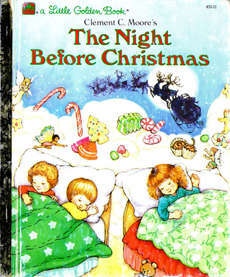
Goldilocks- Lifesavers – Golden Books 1987 #4

Slide 14
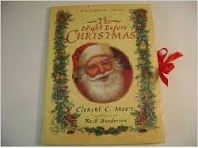
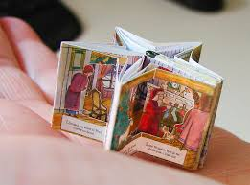
Ruth Sanderson Carousel Book, #86, 1994

Slide 15
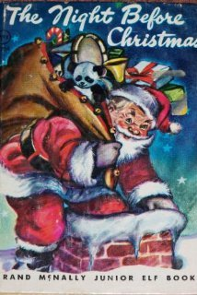
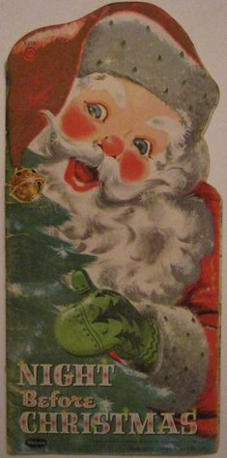
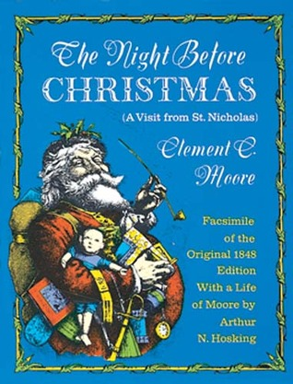
Oldest ones have Whitman c 1950 MCML #175 and c 1958 MCMLVIII #83
Reproduction of Antique edition circa 1870, #24
Facsimile of the Original 1848 Edition #20

Slide 16
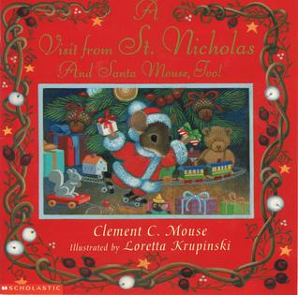
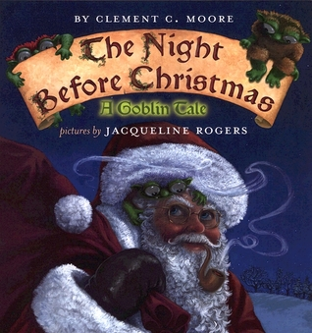
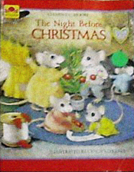
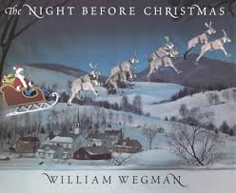
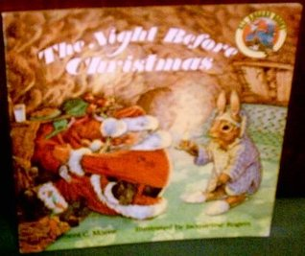
Original Poem with unusual characters
Visit from St. Nicholas And Sant Mouse, Too! #103 , 1998
The Night Before Christmas: A Goblin Tale, #147, 2003
Mice #3 , 1982
Rabbits, #16, 1987
William Wegman’s Weimaraners, #127, 2000

Slide 17
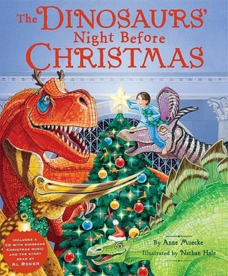
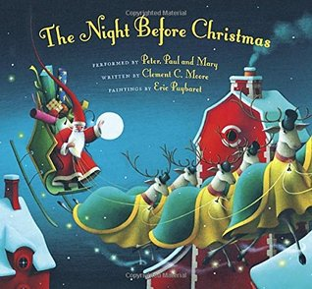
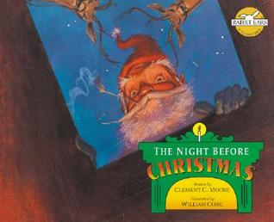
Recordings
The Dinosaurs’ Night Before Christmas, read by Al Roker, #180, 2008
The Night Before Christmas by Peter Paul and Mary, #184, 1996
The Night Before Christmas Rabbit Ears production read by Meryl Streep, #67, 2006

Slide 18
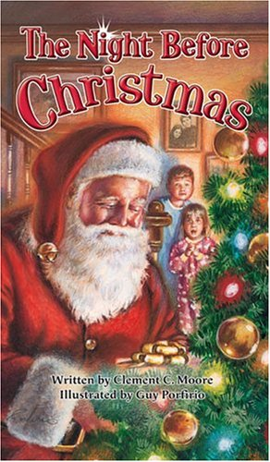
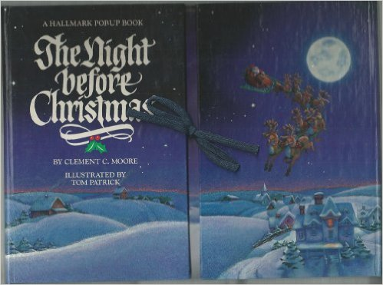
Unfoldable and board pop-up
Hallmark pop-up and bag, #154, 1988,
Unfoldable, #153, 2004

Slide 19
Characters Kids Know (sometimes parody poem)
Barney, #139
Muppets, #64
Elmo, #161
Olaf from Frozen, #194
Pirates, #182,
Pete the Cat, #191
Heathcliff, #46
Little Critter, #69
Garfield, #47
Disney Babies, #57
Teddy Bears, #119
Bugs Bunny , 109

Slide 20
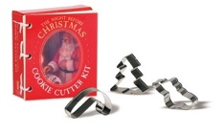
Poem with usable items
Large Gift Bag, #174, Expressions from Hallmark
Cookie Cutter Kit, #160, 2010

Slide 21
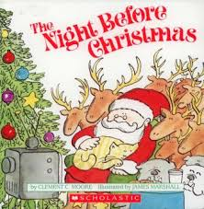
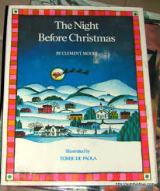
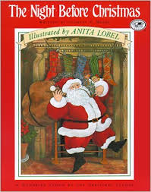
Some well known illustrators
James Marshall #10
Tomie DePaola #60
Anita Lobel #11

Slide 22
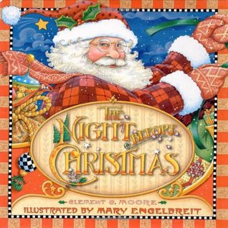
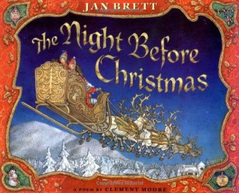
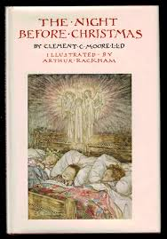
More well known illustrators
Jan Brett #112
Mary Engelbrett #135
Arthur Rackham #79, 115, 1931

Slide 23
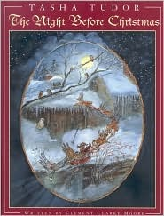
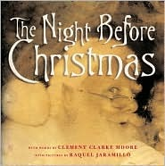
A couple more favorite illustrators
Tash Tudor, #123,1999
Raquel Jaramillo, #142, 2001

Slide 24
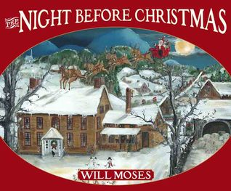
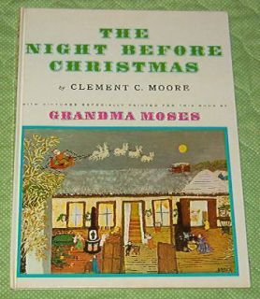
Grandma Moses and Will Moses
Grandma Moses #32, 1948
Will Moses #172, 2006

Slide 25
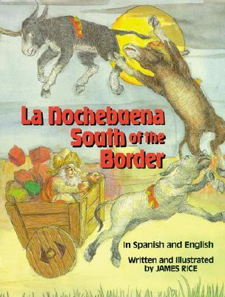
Spanish & English
‘Twas Nocebuena: A Christmas Story in English and Spanish, #190, 2014
La Nocebuena South of the Border, JAMES RICE, #80, 1993

Slide 26
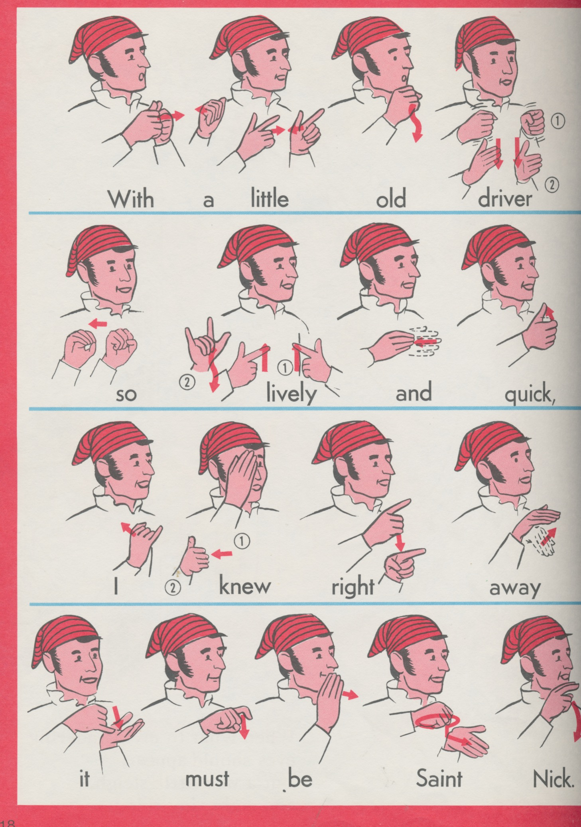
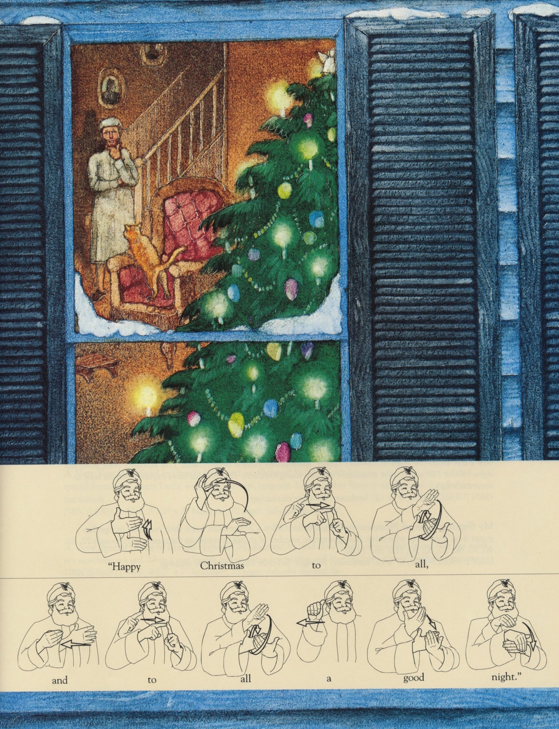
Sign Language, #62 & # 128

Slide 27
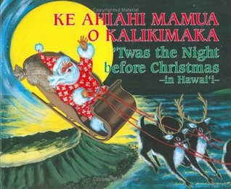
Hawaii
The Night Before Chrismas in Hawaii, #170, 1991
Ke Ahiahi Mamua O Kalikimaka #164 , 1984

Slide 28
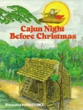
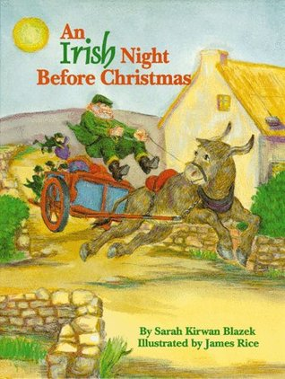
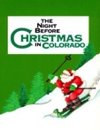
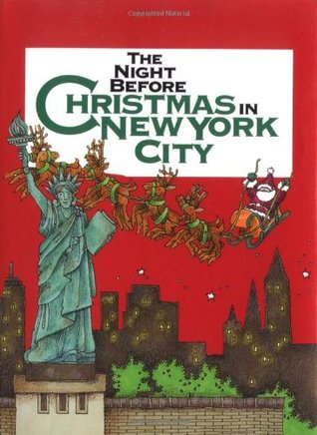
Variations from specific places
Cajun Night Before Christmas by “Tosclair” in 1967, illus. by JAMES RICE, #8, 1988
Since then James Rice has published MANY versions of Night Before. I have 10 others. An Irish Night Before Christmas, #91, 1995
The Night Before Christmas: In Texas That is,, #9, 1952,1980
Gibbs Smith Publishers have from every state.
Colorado #133, 2000
New York City #133, 1994

Slide 29
Rocky Mountain & Cowboy
Cowboy Night Before Christmas, #36, 1986
Cowboy’s Night Before Christmas, #68, 1992
Rocky Mountain Night Before Christmas, #178, 2007

Slide 30
AFRICAN AMERICAN SANTAS
# 151, 2004, Jump at the Sun
# 99, 1996

Slide 31
Search and Find
Hidden Picture Book, #58
Can You See What I See, #159
3-D, #85, Look and Find on the Night Before Christmas, #63,
Search & Find, #173

Slide 32
Pop-ups
Shadow pictures, #49 1992
Pop-up pages, #71, 1992
Full page pop-ups in 2 sizes,
#27, 1987 & 1989
Pop-up full pages, #89, 1993
Random House
Pop-up #26,

Slide 33
Lift the Flaps Rebus, Michael Forman, #18, 1988

Slide 34
Rebus, sticker, & coloring books
Rebus Sticker, #97, 1996
Favorite is Laminated Coloring book which 25 students can use to round robin read in a circle. #15, #19, #41, #59

Slide 35
Shadow pictures, Scratch & Sniff , Glow in the Dark
Bedtime Shadow, #168, 2006
Scratch & Sniff, #187, 2007
Glitter Glow, #134
Watch Me Glow #66

Slide 36
Dogs and Cats Versions
A Dog’s (Cat’s) Night Beforeg Christmas, #113 & #114, 1996
A Dog’s (Cat’s) Night Before Christmas, #156 & #157, 2005
The Night Before Dog-mas, Cat-mas, #121 & #122, 1998

Slide 37
Other Holidays or events
“Twas the Night Before Thanksgiving, #96, 1990 Dav Pilkey
Night Before Kindergarten, #149, 2001. …Halloween, #116, 1999 Fort Collins, Colorado Author Natasha Wing has many variations.

Slide 38
Parody with messages I love
Santa Cows, #50, 1991
Mouse Before Christmas, #108, 1997
Angel Pig…, #105, 1997

Slide 39
School Parodies
A Teacher’s Night Before Christmas, #110, 1996
The Teacher’s (Principals’s) Night Before Christmas, #131 & #140, 2004
By Steven L. Layne with James Rice illustrations
A Teacher’s Tale of The Night Before Christmas, #148, 2002

Slide 40
Before and After Parodies
The Night Before the Night Before Christmas #150, 2002
‘Twas the Night After Christmas: The Untold Story #38, 1990
‘Tis the DayAfter Christmas #73, 1991
The Night After Christmas #145, 1977

Slide 41
Have a Happy Christmas!

